Slide 1
Life history components of Yellowtail Snapper (Ocyurus chrysurus): Otoliths, growth, meristics, and natural mortality
Christopher E. Swanson
Florida Fish and Wildlife Conservation Commission

Slide 2
Number of Otoliths by Fishery Sector
Year | Commercial | Recreational | Fishery Independent
1980 | 0 | 496 | 0
1981 | 153 | 199 | 0
1982 | 0 | 198 | 0
1983 | 0 | 566 | 0
1984 | 0 | 217 | 0
1985 | 0 | 180 | 0
1986 | 0 | 74 | 0
1987 | 0 | 52 | 0
1988 | 0 | 11 | 0
1989 | 0 | 19 | 0
1990 | 0 | 236 | 0
1991 | 0 | 35 | 0
1992 | 107 | 19 | 0
1993 | 174 | 0 | 0
1994 | 262 | 97 | 0
1995 | 270 | 423 | 0
1996 | 400 | 113 | 0
1997 | 977 | 190 | 0
1998 | 512 | 686 | 6
1999 | 833 | 356 | 119
2000 | 541 | 126 | 540
2001 | 638 | 38 | 300
2002 | 454 | 216 | 90
2003 | 341 | 357 | 0
2004 | 444 | 542 | 0
2005 | 676 | 506 | 0
2006 | 707 | 345 | 0
2007 | 360 | 154 | 23
2008 | 825 | 395 | 25
2009 | 742 | 853 | 27
2010 | 498 | 1185 | 91
2011 | 143 | 701 | 0
2012 | 143 | 1635 | 0
2013 | 280 | 1476 | 0
2014 | 3954 | 1565 | 0
2015 | 3416 | 1708 | 0
2016 | 2613 | 1878 | 0
2017 | 1273 | 1453 | 0
Total | 21736 | 19300 | 1221 | 42,257
Percent (%) | 51 | 46 | 3

Slide 3
Otolith Data Sources
Program | COM | FI | REC
ACCSP | 190 | 0 | 231
ACFCMA | 24 | 0 | 62
APages | 0 | 0 | 40
CRP HE | 0 | 0 | 6
FI | 0 | 1055 | 0
FIM | 0 | 166 | 0
FIN-BI | 62 | 0 | 1886
FMR | 20 | 0 | 0
FWCLE | 0 | 0 | 54
HB | 0 | 0 | 14714
Hg/DNA | 9 | 0 | 0
HMS | 0 | 0 | 39
LADWF | 0 | 0 | 1
MRFSS | 0 | 0 | 459
NCDMF | 95 | 0 | 0
OTHER | 23 | 0 | 19
RECFIN | 0 | 0 | 96
RED SN | 0 | 0 | 3
RS BIO | 0 | 0 | 3
SCIENT | 2 | 0 | 0
SEFL C | 0 | 0 | 1069
TIP | 21311 | 0 | 613
TOURNAMENT | 0 | 0 | 5
Total | 21736 | 1221 | 19300 | 42,257
Primary Programs
Rec
Headboat
FIN-BI
SEFL C
Com
TIP

Slide 4
Recreational by region
Year | Unknown | NW_FL to TX | SW_FL | FL_Keys | SE_FL | NE_FL to NC
1980 | 394 | 0 | 0 | 69 | 32
1981 | 0 | 0 | 0 | 91 | 103 | 5
1982 | 0 | 0 | 0 | 62 | 120 | 16
1983 | 0 | 0 | 0 | 52 | 371 | 143
1984 | 0 | 0 | 0 | 0 | 197 | 20
1985 |  | 0 | 0 | 0 | 57 | 121
1986 | 0 | 0 | 9 | 0 | 33 | 32
1987 | 0 | 0 | 0 | 0 | 24 | 28
1988 | 0 | 0 |  | 0 | 6 | 4
1989 | 18 | 0 |  | 0 | 0 | 0
1990 | 232 | 0 | 0 | 0 | 0 | 4
1991 |  | 0 | 0 | 29 | 0 | 4
1992 | 8 | 0 | 0 | 0 | 0 | 11
1994 | 34 | 0 | 0 | 37 | 16 | 10
1995 | 310 | 0 | 0 | 37 | 76 | 0
1996 | 104 | 0 | 0 | 0 | 0 | 9
1997 | 190 | 0 | 0 | 0 | 0 | 0
1998 | 686 | 0 | 0 | 0 | 0 | 0
1999 | 356 | 0 | 0 | 0 | 0 | 0
2000 | 119 | 0 | 0 | 7 | 0 | 0
2001 | 19 | 0 | 0 | 6 | 13 | 0
2002 | 0 | 0 | 8 | 207 | 0
2003 | 0 | 0 | 8 | 60 | 289 | 0
2004 | 0 | 0 |  | 30 | 505 | 6
2005 | 0 | 0 | 9 | 39 | 417 | 41
2006 | 0 | 0 | 4 | 68 | 254 | 19
2007 | 0 | 0 | 0 | 68 | 81 | 5
2008 | 0 | 0 |  | 326 | 67 | 0
2009 | 0 | 13 | 10 | 619 | 210
2010 | 0 | 0 | 5 | 582 | 597
2011 | 0 | 0 | 0 | 690 | 3 | 8
2012 | 0 | 0 | 0 | 1415 | 211 | 9
2013 | 0 | 0 | 0 | 1409 | 51 | 16
2014 | 30 | 0 | 0 | 1509 | 15 | 11
2015 | 10 | 0 | 0 | 1659 | 38
2016 | 0 | 0 | 0 | 1827 | 30 | 21
2017 | 0 | 0 | 0 | 1419 | 18 | 16
Total | 2510 | 13 | 53 | 12317 | 3834 | 559 | 19,286
Percent (%) | 13.01 | 0.07 | 0.27 | 63.86 | 19.88 | 2.90

Slide 5
Headboat by region
 | Unknown | NW_FL_TX | SW_FL | FL_Keys | SE_FL | NE_FL_NC
1980 | 394 | 0 | 0 | 69 | 32 | 1
1981 | 0 | 0 | 0 | 91 | 103 | 5
1982 | 0 | 0 | 0 | 62 | 120 | 16
1983 | 0 | 0 | 0 | 52 | 371 | 143
1984 | 0 | 0 | 0 | 0 | 197 | 20
1985 | 2 | 0 | 0 | 0 | 57 | 121
1986 | 0 | 0 | 9 | 0 | 33 | 32
1987 | 0 | 0 | 0 | 0 | 24 | 28
1988 | 0 | 0 | 1 | 0 | 6 | 4
1989 | 18 | 0 | 1 | 0 | 0 | 0
1990 | 232 | 0 | 0 | 0 | 0 | 4
1991 | 2 | 0 | 0 | 29 | 0 | 4
1992 | 8 | 0 | 0 | 0 | 0 | 11
1994 | 34 | 0 | 0 | 37 | 16 | 10
1995 | 310 | 0 | 0 | 37 | 76 | 0
1996 | 104 | 0 | 0 | 0 | 0 | 9
1997 | 190 | 0 | 0 | 0 | 0 | 0
1998 | 686 | 0 | 0 | 0 | 0 | 0
1999 | 356 | 0 | 0 | 0 | 0 | 0
2000 | 118 | 0 | 0 | 7 | 0 | 0
2001 | 6 | 0 | 0 | 6 | 13 | 0
2006 | 0 | 0 | 0 | 0 | 1 | 0
2009 | 0 | 12 | 0 | 0 | 0 | 0
2010 | 0 | 0 | 0 | 7 | 0 | 1
2011 | 0 | 0 | 0 | 690 | 3 | 8
2012 | 0 | 0 | 0 | 1415 | 211 | 9
2013 | 0 | 0 | 0 | 1409 | 51 | 16
2014 | 0 | 0 | 0 | 1509 | 15 | 11
2015 | 0 | 0 | 0 | 1659 | 38 | 1
2016 | 0 | 0 | 0 | 1827 | 30 | 21
2017 | 0 | 0 | 0 | 1419 | 18 | 16
Total | 2460 | 12 | 11 | 10325 | 1415 | 491 | 14,714
Percent (%) | 16.7 | 1 | 1 | 70.2 | 9.6 | 3.3

Slide 6
Commercial by region
Year | Unknown | NW_FL to TX | SW_FL | FL_Keys | SE_FL | NE_FL to NC
1981 | 153 | 0 | 0 | 0 | 0 | 0
1992 | 107 | 0 | 0 | 0 | 0 | 0
1993 | 174 | 0 | 0 | 0 | 0 | 0
1994 | 262 | 0 | 0 | 0 | 0 | 0
1995 | 270 | 0 | 0 | 0 | 0 | 0
1996 | 400 | 0 | 0 | 0 | 0 | 0
1997 | 977 | 0 | 0 | 0 | 0 | 0
1998 | 512 | 0 | 0 | 0 | 0 | 0
1999 | 833 | 0 | 0 | 0 | 0 | 0
2000 | 541 | 0 | 0 | 0 | 0 | 0
2001 | 629 | 0 | 0 | 9 | 0 | 0
2002 | 0 | 0 | 3 | 451 | 0 | 0
2003 | 0 | 0 |  | 337 |  | 0
2004 | 0 | 0 | 9 | 268 | 162 | 5
2005 | 0 |  | 23 | 393 | 188 | 70
2006 | 0 | 4 | 16 | 297 | 348 | 42
2007 | 0 | 0 | 36 | 206 | 93 | 25
2008 | 0 | 4 | 154 | 423 | 186 | 58
2009 | 0 | 0 | 129 | 534 | 27 | 52
2010 | 0 | 0 | 29 | 369 | 70 | 30
2011 | 0 | 0 | 0 | 0 | 129 | 14
2012 | 0 | 0 | 0 | 90 | 39 | 14
2013 | 0 | 0 | 0 | 162 | 110 | 8
2014 | 0 | 0 | 0 | 3487 | 456 | 11
2015 | 0 | 0 | 0 | 3072 | 334 | 10
2016 | 0 | 0 | 0 | 2429 | 171 | 13
2017 | 0 | 0 | 0 | 1230 | 41
Total | 4858 | 8 | 399 | 13757 | 2354 | 352 | 21,728
Percent (%) | 22.36 | 0.04 | 1.84 | 63.31 | 10.83 | 1.62

Slide 7
TIP by region
 | Unknown | NW_FL_TX | SW_FL | FL_Keys | SE_FL | NE_FL_NC
1981 | 153 | 0 | 0 | 0 | 0 | 0
1992 | 107 | 0 | 0 | 0 | 0 | 0
1993 | 174 | 0 | 0 | 0 | 0 | 0
1994 | 262 | 0 | 0 | 0 | 0 | 0
1995 | 270 | 0 | 0 | 0 | 0 | 0
1996 | 400 | 0 | 0 | 0 | 0 | 0
1997 | 957 | 0 | 0 | 0 | 0 | 0
1998 | 512 | 0 | 0 | 0 | 0 | 0
1999 | 833 | 0 | 0 | 0 | 0 | 0
2000 | 541 | 0 | 0 | 0 | 0 | 0
2001 | 629 | 0 | 0 | 0 | 0 | 0
2002 | 0 | 0 | 3 | 565 | 0 | 1
2003 | 0 | 0 | 2 | 366 | 2 | 0
2004 | 0 | 0 | 9 | 293 | 162 | 6
2005 | 0 | 2 | 23 | 423 | 188 | 40
2006 | 0 | 4 | 16 | 300 | 348 | 42
2007 | 0 | 0 | 36 | 270 | 68 | 25
2008 | 0 | 4 | 154 | 456 | 82 | 58
2009 | 0 | 0 | 129 | 595 | 17 | 47
2010 | 0 | 0 | 29 | 439 | 37 | 26
2011 | 0 | 0 | 0 | 0 | 129 | 14
2012 | 0 | 0 | 0 | 90 | 39 | 14
2013 | 0 | 0 | 0 | 162 | 110 | 7
2014 | 0 | 0 | 0 | 3487 | 456 | 11
2015 | 0 | 0 | 0 | 3072 | 334 | 10
2016 | 0 | 0 | 0 | 2429 | 171 | 11
2017 | 0 | 0 | 0 | 1230 | 41 | 2
Total | 4838 | 10 | 401 | 14177 | 2184 | 314 | 21,924
Percent (%) | 22.07 | 0.05 | 1.83 | 64.66 | 9.96 | 1.43
Notes:
TIP numbers here include both COM and REC

Slide 8
Fork Length Bins from Commercial Otoliths

Slide 9
Fork Length Bins from Commercial Otoliths
21,529 otoliths with associated lengths
1 cm length bins (Fork Length)
Grey areas represent length bins where number of otoliths is <10
Most lengths between 24 – 46 cm
Minimum size currently 12” -> 24.8 cm
2011-2012: lowest number of samples
2014 – 2017: highest number of samples
~6x higher avg than previous years avg

Slide 10
Fork Length Bins from Recreational Otoliths

Slide 11
Fork Length Bins from Recreational Otoliths
18,280 otoliths with associated lengths
1 cm length bins (Fork Length)
Grey areas represent length bins where number of otoliths is <10
Most lengths between 23 – 38 cm
Minimum size currently 12” -> 24.8 cm
Late 1980s and early 1990s: lowest number of samples
2009 – 2017: highest number of samples

Slide 12
Modeling Growth:
97% of otoliths come from fishery-dependent sources with minimum size limit regulations intact for majority of the timeseries
Timeseries of previous assessment began in 1981
FWC state regulations begin July 1, 1985 with 12” TL min size
SAFMC FMP establishes 12” TL min size 8/31/83
GMFMC FMP establishes 12” TL min size 2/21/90
Produces truncated age-length data
“Many samples of age-length pairs collected from fishery landings show a peculiar pattern where young animals appear to grow very quickly and then suddenly slow down. In many cases this is primarily a consequence of minimum size limit regulations; fish smaller than the limit are not landed and therefore do not appear in the sample...one must use a model-based approach to adjust for the effects of the minimum size limits.” (Diaz et al. 2004, SEDAR 7-AW-1)

Slide 13
Modeling Growth:
What was done in the previous SEDAR 27A?
A truncated von Bertalanffy growth curve was used following the 12” (305 mm) TL minimum size for state waters beginning on 7/1/85
See Diaz et al. 2004, SEDAR 7-AW-1
For fishery-independent data and fishery-dependent data prior to the regulation, an assumed minimum size limit of 150 mm TL was used
Will likely need to continue to account for this truncation
Could explore modelling growth on only FI and pre-regulation FD data for comparison?

Slide 14
Modeling Growth:
Age_1_Jan vs. Bio_age
Last assessment converted ages to biological ages based on a June 1 hatchdate
Ages become decimal based on month of capture
VB parameters used for age-length-keys and for the Lorenzen-M estimator
Continue with this approach or use integer ages?
Fork Length or Total Length?
Datasets contain a mix of fork and total length measurements
See previous SEDAR 27A section II chapter 5.5.2 (Morphometrics)
Discrepancies between how programs measure fish and the use of TL_{relaxed} and TL_{max} measurements
Last assessment model used TL_{max} to model growth
Fork length a bit more conspicuous and may be more appropriate for this species
Continue with use of TL_{max} or move to FL measurements to model growth and Lorenzen-M estimator?

Slide 15
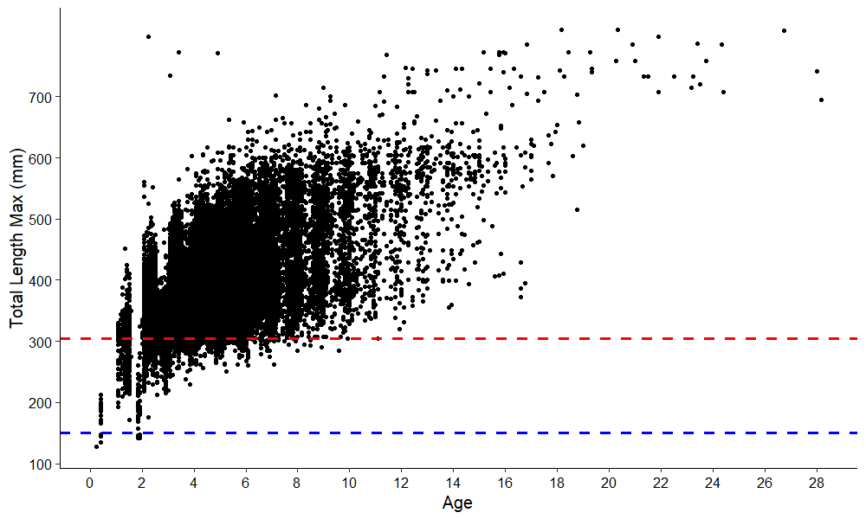
Age-length data (n=41,522 otoliths)
305 mm
150 mm

Slide 16
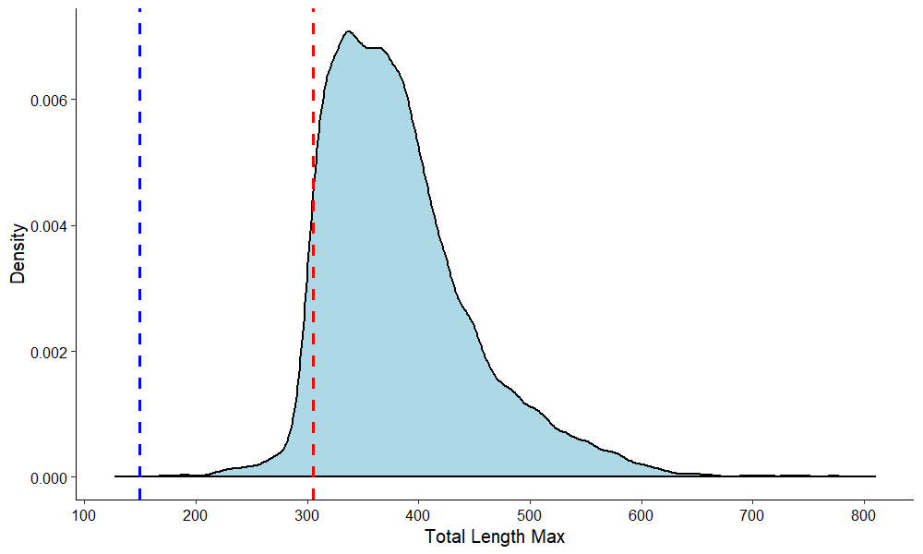
Length distribution (n=41,522 otoliths)
150 mm
305 mm
FD data prior to 7/1/85 or FI data
FD data after 7/1/85 or FI data or

Slide 17
Estimating Sigma:
Sigma difficult to estimate with truncated data
Ad-hoc regressions on the standard deviations of length at age (Diaz et al. 2004)
Linear regression (sd_lin_est = age* x₁ + intercept
Sigma explored using 4 methods in previous assessment
Sigma = 1
Sigma estimated with linear regression
Sigma estimated with linear regress and t0=0
Sigma estimated with polynomial regression
sd_poly_est = age²*x₁ + age*x₂ + intercept
Better fit to the data
This was accepted as best fit
**Models explored so far need more work. In some of these methods using updated data, models are showing unrealistic t0 values (e.g. -7.8) and K hitting the lower bounds (e.g. 0.05)**

Slide 18
Application to Stock Synthesis:
Stock Synthesis requires a CV, not sigma, when estimating the VB parameters
Need to provide lower bounds, upper bounds, and an initial value to estimate across
Linear regression (red line) provides initial value
Can disregard low CV values on upper end of ages where sample sizes are very small

Slide 19
Exploring only FI or pre-reg data:
N = 3,114 otoliths
VB with t0 (green line)
Linf = 564
K = 0.182
t0 = -2.2584
VB without t0 (grey dashed line)
Linf = 451
K = 0.5317

Slide 20
Length-length (mm) relationships for South Florida Yellowtail Snapper (Ocyurus chrysurus). Regressions are in the form Y = a + bX.
SL: standard length (mm); FL: fork length (mm); TL: total length (mm); TW: total weight (kg), GW: gutted weight (kg).
LENGTH-LENGTH (linear model Y = a + bX)
Source | Y (mm) | a (mm) | b | X (mm) | n | Min X (mm) | Max X (mm) | Avg. X* (mm) | MSE* | Adj. r² | Σx²* | Σxy* | Σy²*
SEDAR 64 | SL ª | -8.5525 | 0.8961 | FL | 5,873 | 230 | 548 | 309.8 | 24.19173 | 0.99 | 14972185.85 | 13416497.58 | 12164483.12
 | TL_{relaxed} ^{b}** | -14.7197 | 1.2727 | FL | 16,212 | 205 | 550 | 304.8 | 75.76723 | 0.98 | 32304484.82 | 41115136.35 | 53556971.66
 | TL_{max} ^{c} | -16.4139 | 1.2969 | FL | 6,827 | 225 | 548 | 308.1 | 32.20539 | 0.99 | 16365227.67 | 21223574.86 | 27744021.96
SEDAR 27A | TL_{max} | -14.947 | 1.290 | FL | 3,036 | 233 | 548 |  |  | 0.99
SEDAR 3 | TL_{max} | -23.117 | 1.313 | FL | 409 | 233 | 506 |  |  | 0.98
Johnson (1983) | FL | 17.7 | 0.78 | TL_{max} | 100 |  |  |  |  | 0.97
Garcia et al. (2003) | FL | 7.56 | 0.79 | TL_{relaxed} | 1,264 | 240 | 780 |  |  | 0.95
SEDAR 27A | TL_{relaxed} | -8.604 | 0.991 | TL_{max} | 3,008 | 266 | 684 |  |  | 0.99
ª reverse prediction: FL = 9.5441 + 1.1159 * SL
^{b} reverse prediction: FL = 11.5657 + 0.7857 * TL_{relaxed}
^{c} reverse prediction: FL = 12.6563 + 0.7711 * TL_{max}

Slide 21
Length-weight relationships (nonlinear estimation) for Yellowtail Snapper in waters off of Southern Florida.
FL: fork length (mm); TL: total length (mm); TW: total weight (kg), GW: gutted weight (kg).
LENGTH-WEIGHT (nonlinear model: weight = a * Length^{b} )
Source | Y [kg] | a | b | X[mm] | n | Min [mm] | Max [mm] | MSE
SEDAR 64 | TW | 3.396E-08 | 2.8797 | FL | 16,540 | 202 | 550 | 0.00200
 | TW | 4.035E-08 | 2.7487 | TL_{relaxed} | 10,792 | 247 | 697 | 0.00267
 | TW | 3.214E-08 | 2.7849 | TL_{max} | 1,763 | 284 | 654 | 0.00367
 | GW | 6.152E-08 | 2.7691 | FL | 4,052 | 232 | 548 | 0.00311
 | GW | 5.156E-08 | 2.7086 | TL_{relaxed} | 1,955 | 277 | 662 | 0.00430
 | GW | 5.273E-08 | 2.6935 | TL_{max} | 1,838 | 281 | 684 | 0.00403
SEDAR 27A | TW | 6.135E-08 | 2.779 | FL | 8,273 | 146 | 792 | 0.00820
Source | Y [kg] | a | b | X[cm] | n | Min [cm] | Max [cm] | MSE
SEDAR 64 | TW | 2.070E-05 | 2.8797 | FL | 16,540 | 20.2 | 55.0 | 0.00200
 | TW | 2.459E-05 | 2.7487 | TL_{relaxed} | 10,792 | 24.7 | 69.7 | 0.00267
 | TW | 1.959E-05 | 2.7849 | TL_{max} | 1,763 | 28.4 | 65.4 | 0.00367
 | GW | 3.749E-05 | 2.7691 | FL | 4,052 | 23.2 | 54.8 | 0.00311
 | GW | 3.142E-05 | 2.7086 | TL_{relaxed} | 1,955 | 27.7 | 66.2 | 0.00430
 | GW | 3.213E-05 | 2.6935 | TL_{max} | 1,838 | 28.1 | 68.4 | 0.00403
SEDAR 27A | TW | 3.739E-05 | 2.779 | FL | 8,273 | 14.6 | 79.2 | 0.00820

Slide 22
Natural Mortality
Previous Assessment SEDAR 27A
Assumed M was inversely related to fish length (Lorenzen 2005)
Used Hoenig (1983) method to calculate a constant mortality at age estimate derived from a max age of 23
M was scaled so that the cumulative instantaneous rate predicted during ages 3 – 20 was the same as the Hoenig estimate
Fish were fully vulnerable to gear between age 3 – 20
Length at age required for this was predicted using the von Bertalanffy growth model

Slide 23
Natural Mortality
Lots of ways to empirically calculate M. Some options to consider for this assessment following previous methods:
Can use the same Lorenzen scaled approach but update Hoenig (1983) to Then et al (2015) and use a new maximum age of 28
Can also modify the original equation from Then et al. (2015) so that it derives a constant mortality at age using only data from similar species (e.g. snappers, groupers, grunts, jacks)
Original equation 4.8992^(-0.9162 * tmax) becomes 4.0809^(-0.9012 * tmax)
Munyandorero (2019, in review) presents M at age (M_{a}) using a constant M and VB parameters following Kai and Fujinami (2018) and Lorenzen (2011)

