Slide 1
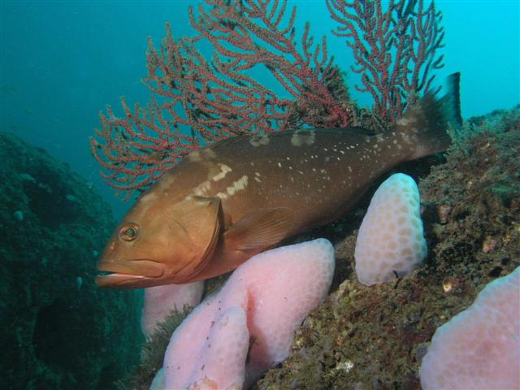
SEDAR 42: US Gulf of Mexico Red grouper assessment
Review Workshop
Data inputs
SEFSC
July 14 - 16, 2015

Slide 2
SEDAR 42 Red Grouper Assessment
Data inputs
Assessment model configuration
Model fit to data
Model diagnostics
Stock status determination
Projections
Notes:
Order of presentation

Slide 3
Data inputs
Landings
  Handline: 1986-2013
  Longline: 1986-2013
  Trap: 1986-2006
  Charter/Headboat/Private: 1986-2013
Discards
  Handline: 2007-2013 (observer program)*
  Longline: 2007-2013 (observer program)*
  Trap: (self reported)*
  Charter/Headboat/Private: 1986-2013
Length composition of discards
  Handline: 2006-2013 (observer program)
  Longline: 2006-2013 (observer program)
  Charter: 2010-2013 (observer program)
  Headboat: 2005-2007, 2009-2013 (observer program)
Age composition of retained catch
  Handline: 1991-2013
  Longline: 1991-2013
  Charter/Headboat/Private: 1991-2013
Abundance indices
  Handline: 1993-2009**
  Longline: 1993-2009**
  Charter/Private: 1986-2013
  Headboat: 1986-2013
  Combined video survey: 1993-1997, 2002, 2004-2013***
  SEAMAP summer groundfish survey: 2009-2013
  NMFS bottom longline survey: 2001, 2003-2013
Length composition of fishery-independent indices
  Combined video survey: 2008-2013
  SEAMAP summer groundfish survey: 2009-2013
  NMFS bottom longline survey: 2001-2013
Notes:
The assessment uses a number of different data inputs.
*reconstructed back to 1993
**Truncated at 2009, index does not include IFQ years
***Combination of multiple surveys
We will discuss starred items when we go over each data component.

Slide 4
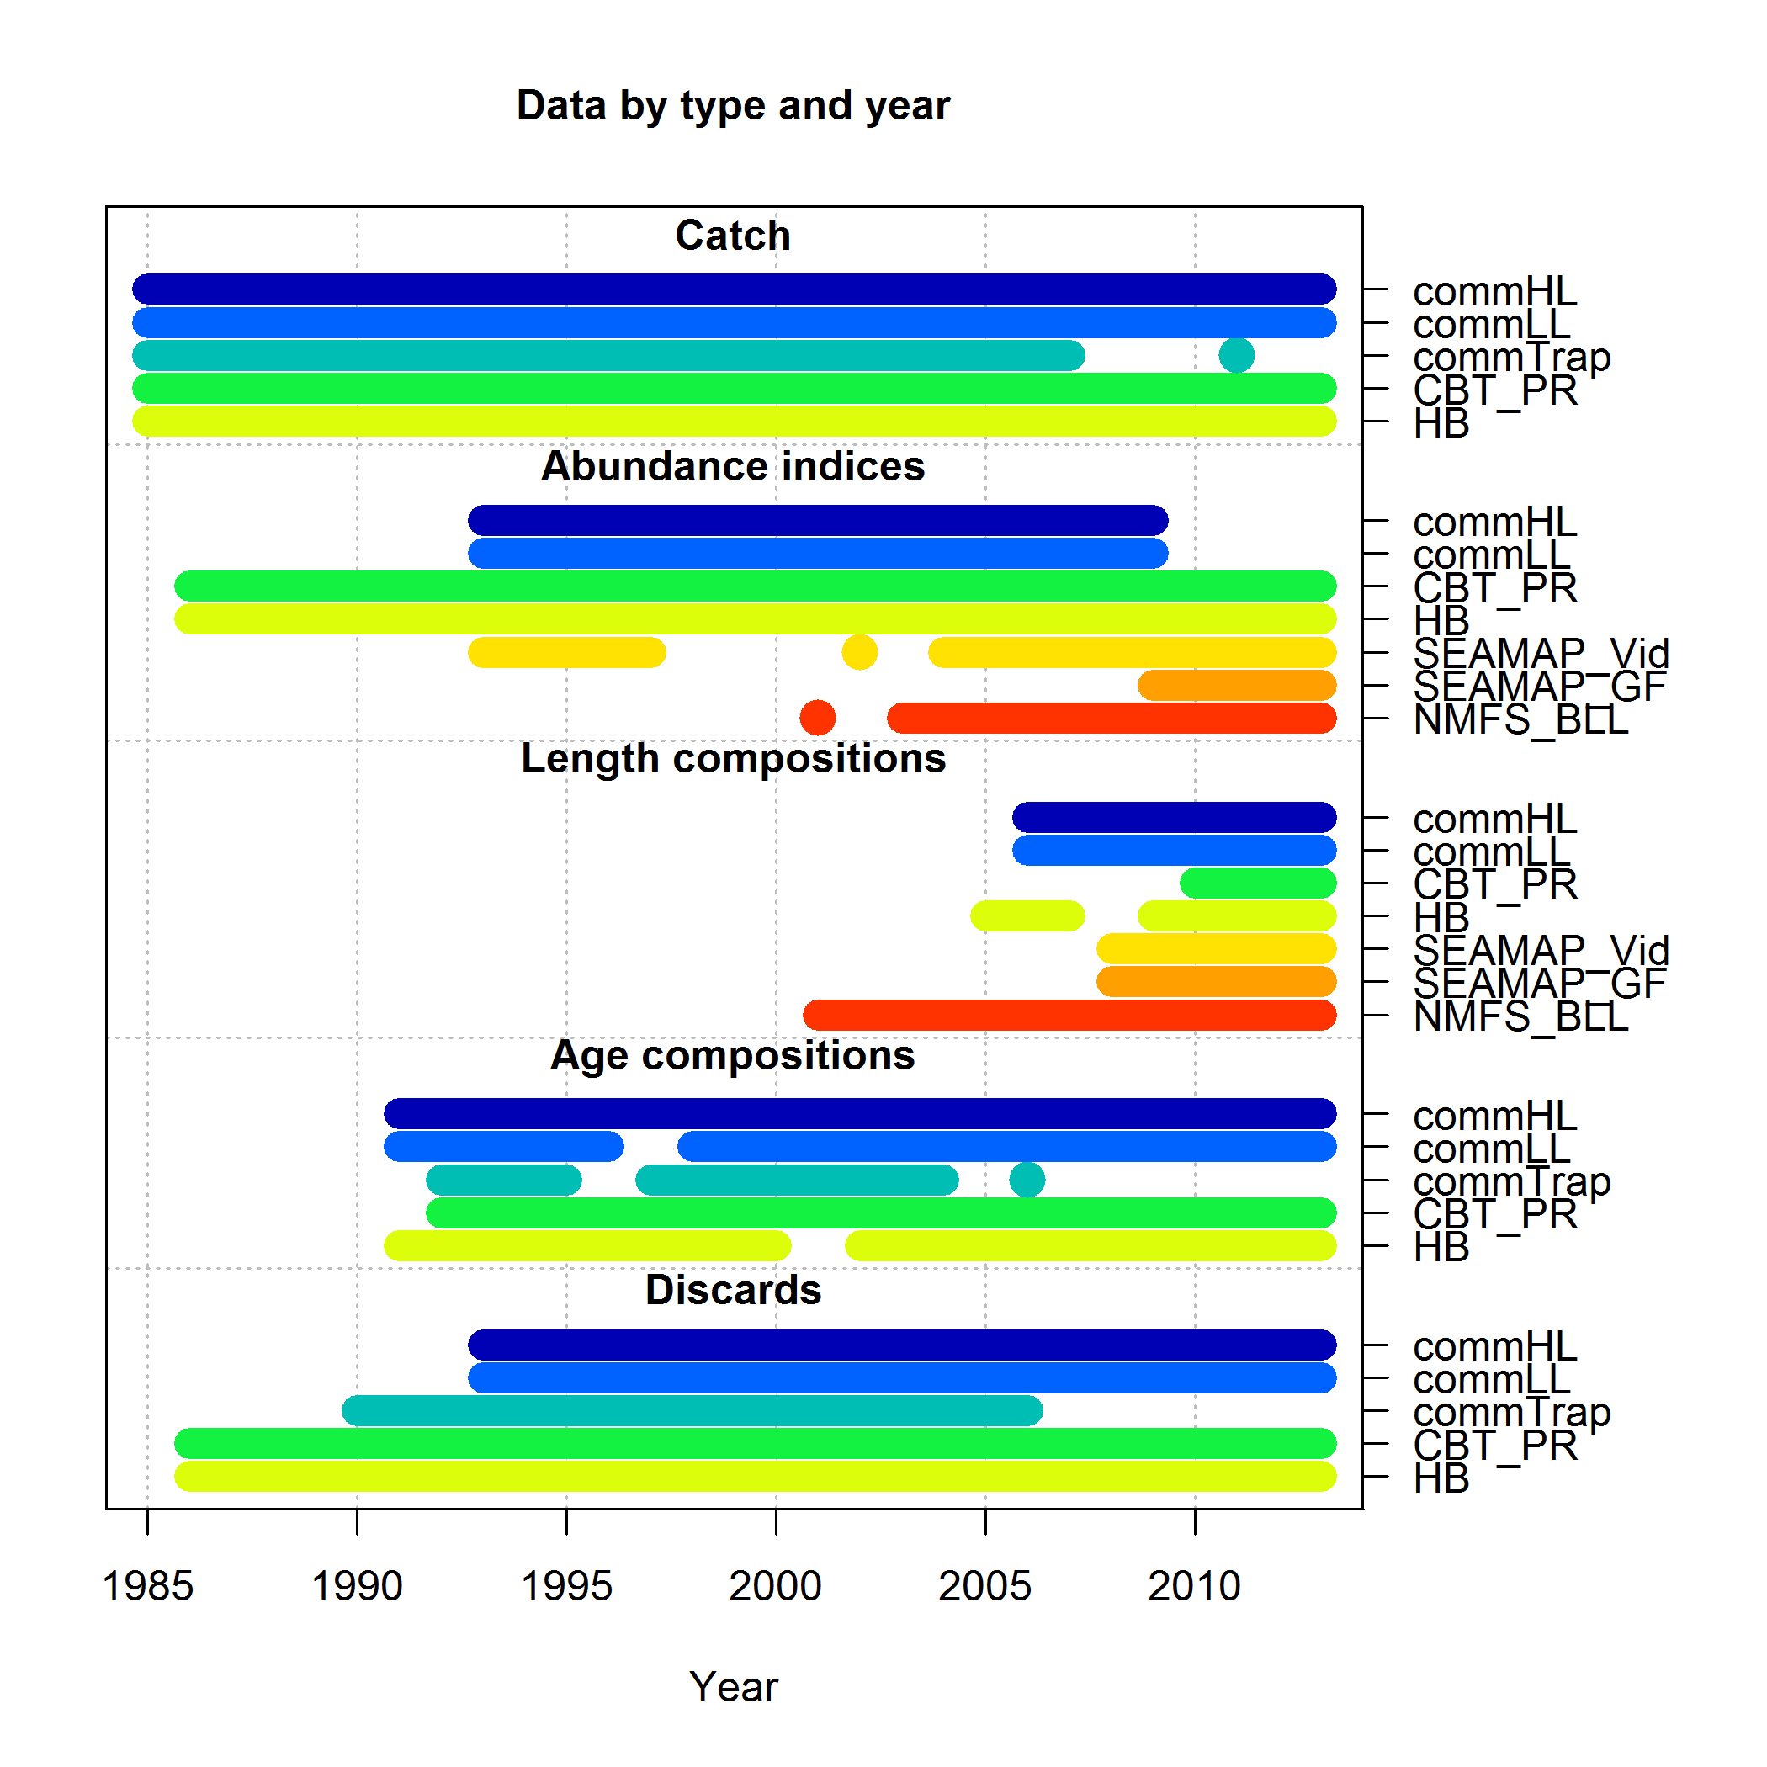
Data inputs
Notes:
This is a nice summary figure that shows the time line of data inputs
Syr varies for each data program
Landings: Traps closed in 2006, all others start in 1986 and end in 2013
Indices: Starting year varies by data program, commercial truncated because of the implementation of the IFQ program
Length of discards and fishery-independent surveys
Age composition: Trap disappears due to the outlawing of trap fishing
Discards: Trap disappears due to the outlawing of trap fishing

Slide 5
Landings
Commercial
  Fleets
    Handline (1986-2013)
    Longline (1986-2013)
    Trap (1986-2006)
Recreational
  Fleets
    Charter/Private: (1986 – 2013)
    Headboat: (1986 – 2013)
Notes:
Going to review the landings for each of these fleets

Slide 6
Commercial landings
Data Sources
  Accumulated landings system (ALS)
  Florida trip ticket
    Florida landings
  Individual Fishing Quota (IFQ) Program
    Landings in IFQ years

Slide 7
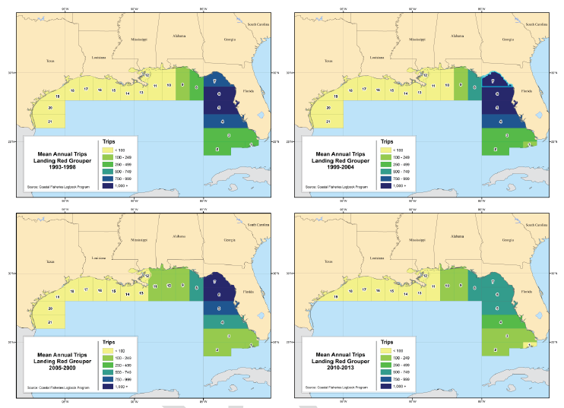
Mean annual commercial trips by area
1993-1998
1999-2004
2005-2009
2010-2013
Notes:
Dark blue means more and yellow means less
Take home: Majority of trips are within Eastern GOM off of FL.

Slide 8
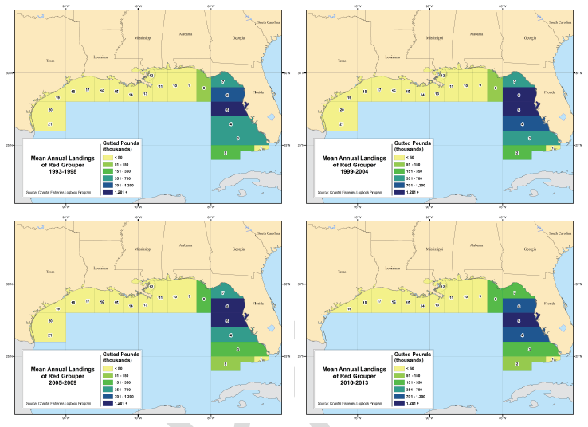
Mean annual commercial landings by area
1993-1998
1999-2004
2005-2009
2010-2013
Notes:
Dark blue means more and yellow means less
Take home: Majority of landings are within Eastern GOM off of FL. Spatial distribution of trips and landings match.

Slide 9
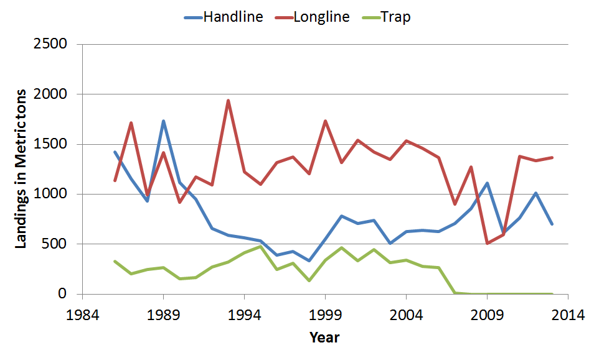
Commercial landings
Longline predominant fishery followed by handline and trap
  Longline and handline landings similar at start and end of time-series
  Longline landings ~2x greater than handline between 1993 and 2005
Trap landings drop to zero after 2006
  Outlawed fishing practice

Slide 10
Recreational landings
Data sources:
  Marine Recreational Fisheries Statistics Survey (MRFSS) and Marine Recreational Information Program (MRIP)
    Provides estimates for all recreational modes except headboat after 1986
    Covers Florida to Louisiana
  Southeast Region Headboat Survey (SRHS) logbook program

Slide 11
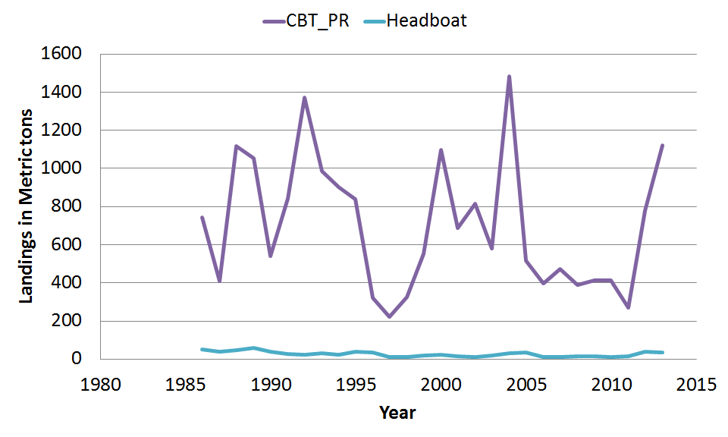
Recreational landings
Majority of recreational landings are from the Charter/Private fleet
Charter/Private landings show high variability with periods of higher and lower average landings
Notes:
WHAT IS BIG DECLINE IN CHARTER/PRIVATE DUE TO?

Slide 12
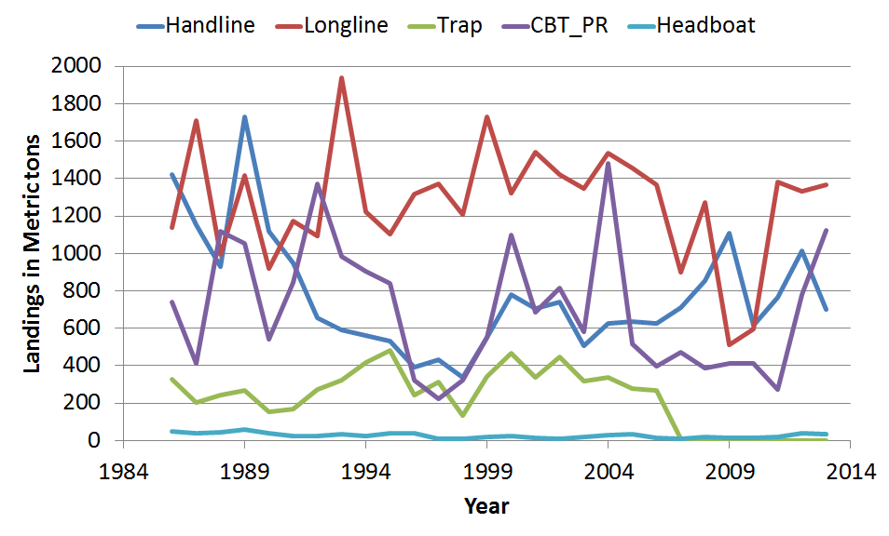
Commercial and recreational landings
Avg ~ 43%
Avg ~ 26%
Avg ~ 22.5%
Avg ~ 7.2%
Avg ~ 0.9%
Predominant fleets are commercial longline and handline, and recreational charter/private
~76% commercial
~24% recreational
Notes:
Don’t need to explain trends.
~76% of the landings are attributed to the commercial fishery
~24% of the landigns are attributed to the recreational fishery
Predominant fleets are longline (red), handline (blue), and Charter/Private(purple)

Slide 13
Discards
Commercial Trap 1990-2005
Commercial HL & LL 1993-2013
Recreational Charter/Private 1986-2013
Recreational Headboat 1986-2013
Notes:
We have discards for every fleet that we have landings. Start year varies by data source and all end in 2013 except trap, which were banned in 2006.
1990-1992 HL & LL estimates not possible since FL only had 20% reporting
Estimated recreational discards go back to start of landings time series

Slide 14
Commercial Trap Discards (1990-2006)
Self-reported effort 1990-2006
Self-reported discard rate 2001-2006
Method from SEDAR12 update (2009)
Discards = Self. Reported Rate * Annual Total Effort
(by strata: targeting only significant factor/strata in GLM)
  1990-2000: Average rate for 2001-2006
  2001-2006: Annual rates
Notes:
Targeting determined using Stephens and MacCall
Two data sources: self-reported

Slide 15
Preliminary estimates based on SEDAR update
Commercial HL and LL Discards (1993-2013)
Self-reported total effort 1993-2013
Observed discard rate 2007-2013
Preliminary discard estimation method:
Discards = Obs. Discards Rate * Annual Total Effort
(by strata: gear, area, size limit, season, allocation, depth)
1993-2006: Average rates for 2007-2009 (Pre-IFQ)
2007-2013: Annual rates
Notes:
Similar to trap, but replaces self-reported discard rates with observer discard rates
Observer program started in 2006, but 2007 is first full year
1990-1992 HL & LL effort estimates not possible since FL only had 20% reporting

Slide 16
Preliminary estimates based on SEDAR update
Commercial HL and LL Discards (1993-2013)
Discards = Obs. Discards Rate * Annual Total Effort
DW recommended exploring total effort
To do so, calculated observer landings were compared to official estimated landings for HL and LL (next slide):
Obs. Calculated landings = Obs. Kept Rate * Total Effort
Based on results, HL and LL estimates of total effort were deemed unreliable

Slide 17
Preliminary estimates based on SEDAR update
Commercial HL and LL Discards (1993-2013)
~ 5x
~ 2/3 most years
Official landings compared to calculated landings
Obs. Calculated landings = Obs. Kept Rate * Total Effort
Notes:
Figures show a comparison of official landings to calculated landings using the equation
TAKE HOME: Using observed rates and multiplying by total effort does not get us in the ballpark of what the landings are. A new method has been proposed until this can be further explored.
Calculated observer landings results in a 5x over etimate for Vertical Line in all years, and a 65% or near 2/3 underestimate of landings for longline in most years.

Slide 18

Commercial HL and LL Discards (1993-2013)
Official landings by strata 1993-2013
Observer discard and kept rates 2007-2013
Current discard estimation method:
(by strata: year, subregion, season, fishery, allocation)
1993-2006: Average rates for 2007-2009 (Pre-IFQ)
2007-2013: Annual rates
Notes:
Observer program started in 2006, but 2007 is first full year
1990-1992 HL & LL effort estimates not possible since FL only had 20% reporting

Slide 19
Commercial HL and LL Discards (1993-2013)
Strata
1993-2006: subregion, season, fishery
2007-2013: year, subregion, season, fishery, allocation
Subregion | East, West
Season | Open season, Closed Season
IFQ allocation | None, 1+ Pounds, applicable to 2009-2013 only
Fishery | shark or reef fish, applicable to bottom longline only
Commercial discards for present assessment were substantially higher than commercial discards in previous assessments.

Slide 20
Commercial HL and LL Discards (1993-2013)
Compared to 2009 SEDAR Estimates (1993-2008)
New method leads to larger estimated of discards
High discards are supported by high discard fractions on observed trips
Notes:
New methods results in as high as 4x higher Vertical Line discards in 2008, and as high as 7x higher longline discards in 1993
High discards supported by high discard fractions on observed trips.

Slide 21
Commercial discards
Longline over 50% of annual discards
  Except 2009 and 2010
At its highest in 1996, trap 22% of annual discards
Notes:
Longeline made up over 50% of discards in all years except 2009 and 2010
At its highest in 1996, trap made up 22%

Slide 22
Recreational Charter/Private Discards (1986-2013)
Self-reported discards 1986-2013
1986-2013: estimated/adjusted in the same manner as self-reported landings
Notes:
Self-reported discards are expanded by total effort using MRFSS/MRIP strata
Strata: Mode, year, wave, distance from shore, region

Slide 23

Recreational Headboat Discards (1986-2013)
Self-reported landings/discards CB proxy 1986-2006
Self-reported HB discards and landings 2007-2013
Observed data 2007-2013
2007-2013: Self-reported discards validated by obs. data
1986-2006: Charterboat proxy:
2007-2013
1986-2006
1986-2006
Notes:
CB proxy chosen based on similarity in magnitude
(SRHS discard:landings to MRIP CB discard:landings)

Slide 24
Recreational Discards
Notes:
Majority of recreational discards are associated with the Charter/Private fleet. On average 95% of annual recreational discards are from this fleet

Slide 25
Discards
‘93-’06 ‘07-13
49% 53%
33% 26%
12% 18%
4% 2.5%
1.5% 0%
Notes:
1993-2006 order of discard magnitude by fleet is same to order of magnitude of landings by fleet

Slide 26
Discard Mortality
FWC Observer Program 2009-2013
NMFS Observer Program 2006-2013
Fleet | Data Source | Discard Rate | Sensitivity Rates
Recreational Fleets | FWC Obs. Program | 11.6% | 5.8%, 14.5%
Commercial HL | FWC Obs. Program (41-50m only) | 19% | 10.0%, 31.0%
Commercial LL Pre-IFQ | NMFS Obs. Program | 41.4% | 34.3%, 48.7%
Commercial LL Post-IFQ | NMFS Obs. Program | 43.6% | 36.7%, 50.8%
Commercial Trap* | SEDAR update 2009* | 10%
*No new data on discard mortality rates available.
10% used in past assessments (2002, 2006, and 2009)
Notes:
Rec: Overall depth-integrated estimate
HL: FWC Obs. data limited to 41-50m. Comm. Obs. data used to select mean depth range.Assumes retrieval time and handling time similar to rec. hook-and-line.
LL: Longer retrieval and handling than other gears. Rates from observer data by depth bin combined using weighted average (weighted by number of sets)
Trap: Discussed and used in all past assessments (2002, 2006, and 2009)

Slide 27
Indices of abundance
Indices working group recommended four fishery-dependent indices and three fishery-independent indices for use in the assessment model

Slide 28
Indices of abundance
Fishery-dependent
  Commercial handline (1993-2009)
  Commercial longline (1993-2009)
  Charter/Private (1986-2013)
  Headboat (1986-2013)
Fishery-independent
  SEAMAP summer groundfish survey: 2009-2013
  NMFS bottom longline survey: 2001, 2003-2013
  Combined video survey: 1993-1997, 2002, 2004-2013
    SEAMAP video: 1993-1997, 2002, 2004-2013
    PC Lab video: 2005-2013
    FWRI video: 2008-2013
Fishery-dependent indices, SEAMAP summer groundfish, & NMFS bottom longline
PC lab video
FWRI video
SEAMAP video
Notes:
The indices cover the eastern Gulf of Mexico - FL and a portion of Alabama

Slide 29
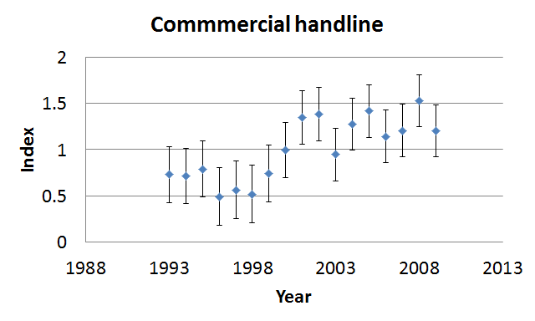
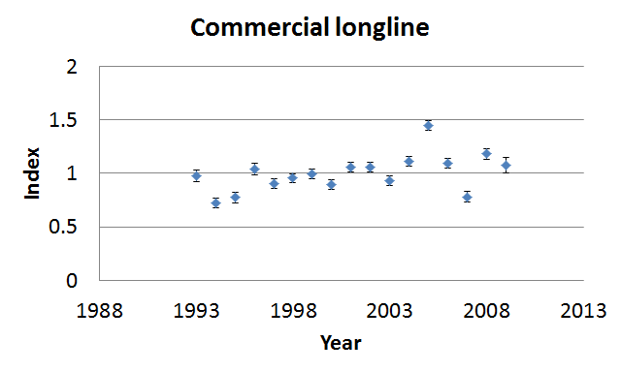
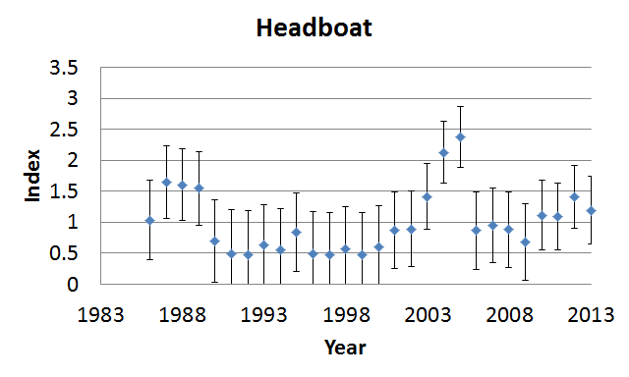
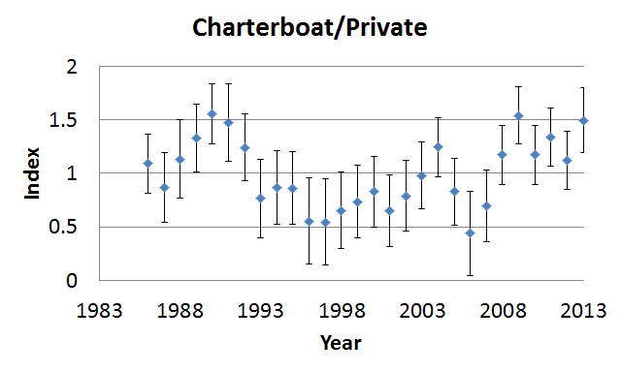
Fishery-dependent indices
Notes:
CV converted to log-scale standard errors – bars rep log-scale SE
CVSs are not indicative of how well the index tracks biomass.

Slide 30
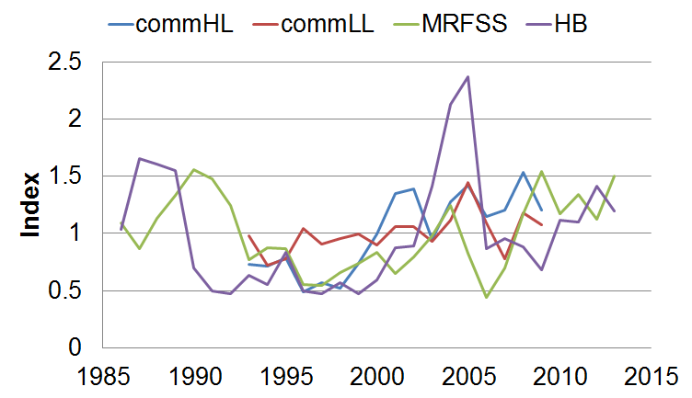
Indices
Fishery-dependent
Notes:
Indices track diff portions of the pop, all generally have similar increasing trend between 1993 – 2005
A few years of conflicting info at the beginning and end of the 2 rec fleets.
Red tide effect apparent after 2005 especially for headboat.
Two indices going furtherest back in time are CBT_PR and Headboat. Start similarly but the initial trends are in opposition until about 1993 and then they each generally increase. The increase also corresponds to increasing comm HL and comm LL indices.
Handline does not peak like the others in 2004-2005. See dramatic declines in CBT_PR, headboat, and commLL after 2005.

Slide 31
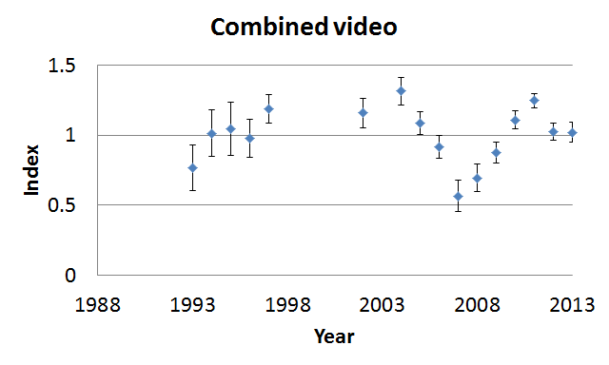
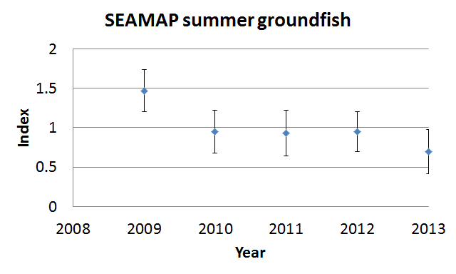
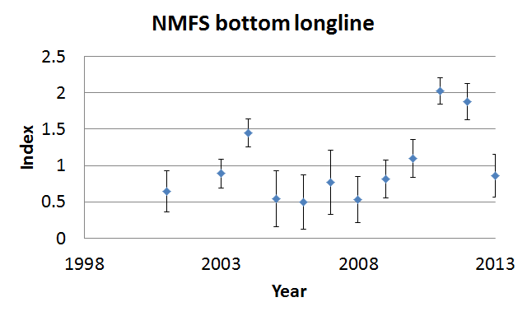
Fishery-independent indices
Notes:
CV converted to log-scale standard errors – bars rep log-scale SE
CVSs are not indicative of how well the index tracks biomass.

Slide 32
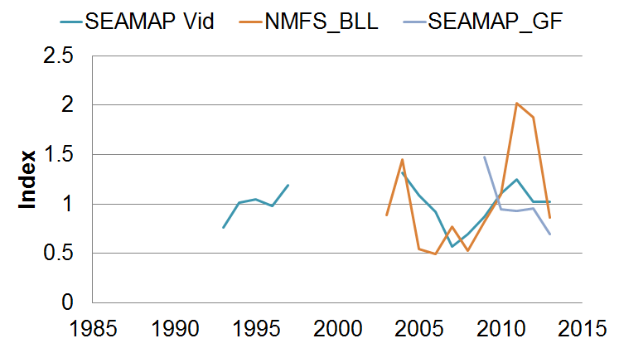
Indices
Fishery-independent
Notes:
Indices track different portions of the population, Groundfish survey captures smallest range of red grouper compared to the others. It declines from 2009 to 2013 while the others increase until 2011 before declining

Slide 33
Age composition
Data sources
  Commercial fleets (1991-2013)
    Trip Interview Program (TIP)
  Recreational fleets (1991-2013 )
    MRFSS/MRIP
    SRHS
    GulfFIN
    TIP

Slide 34
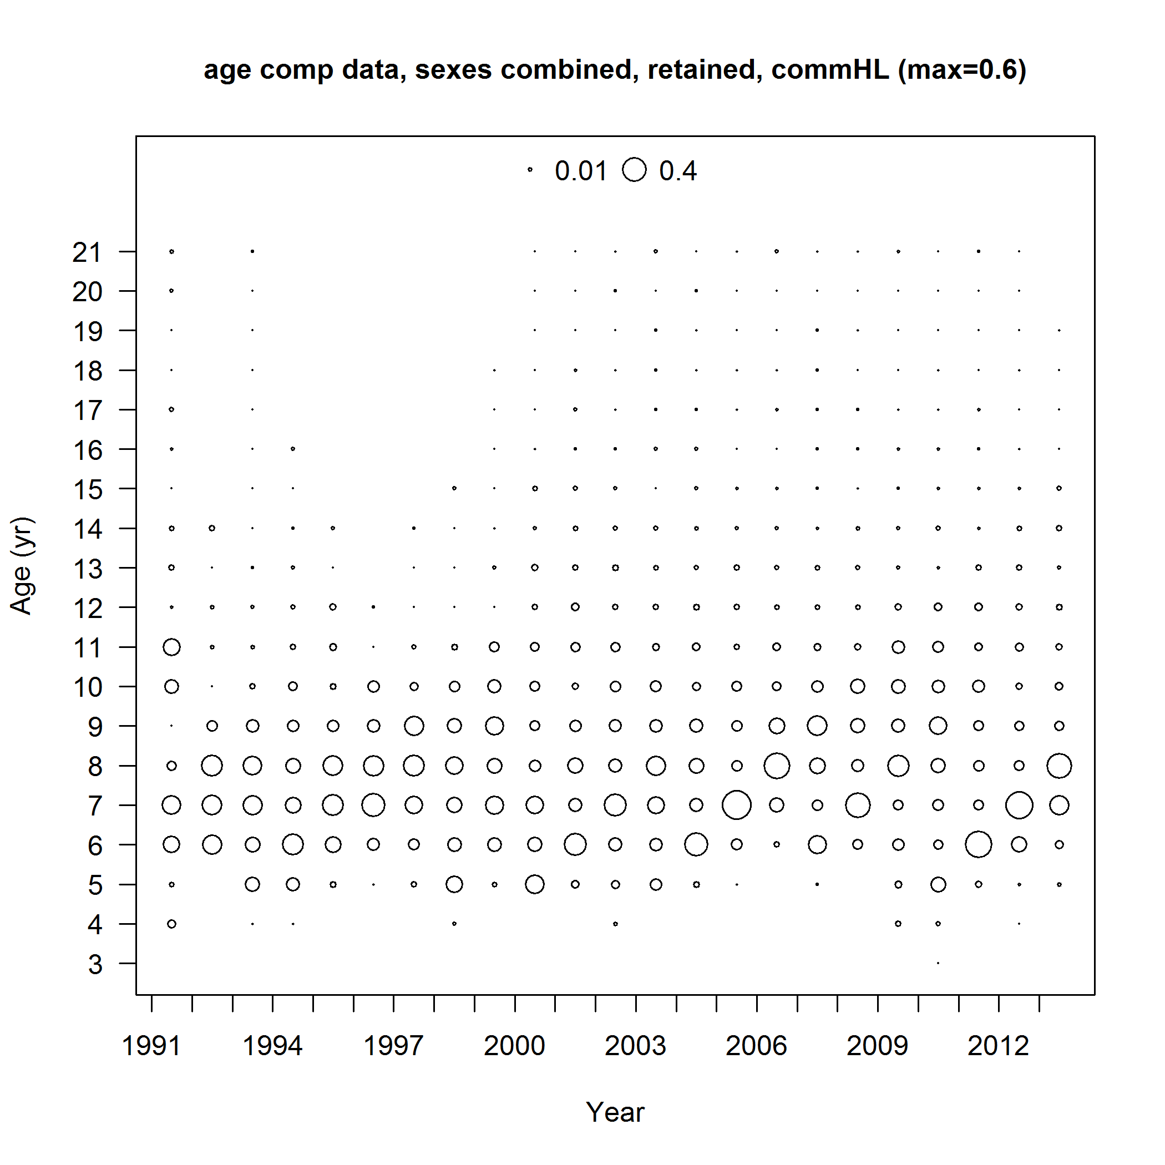
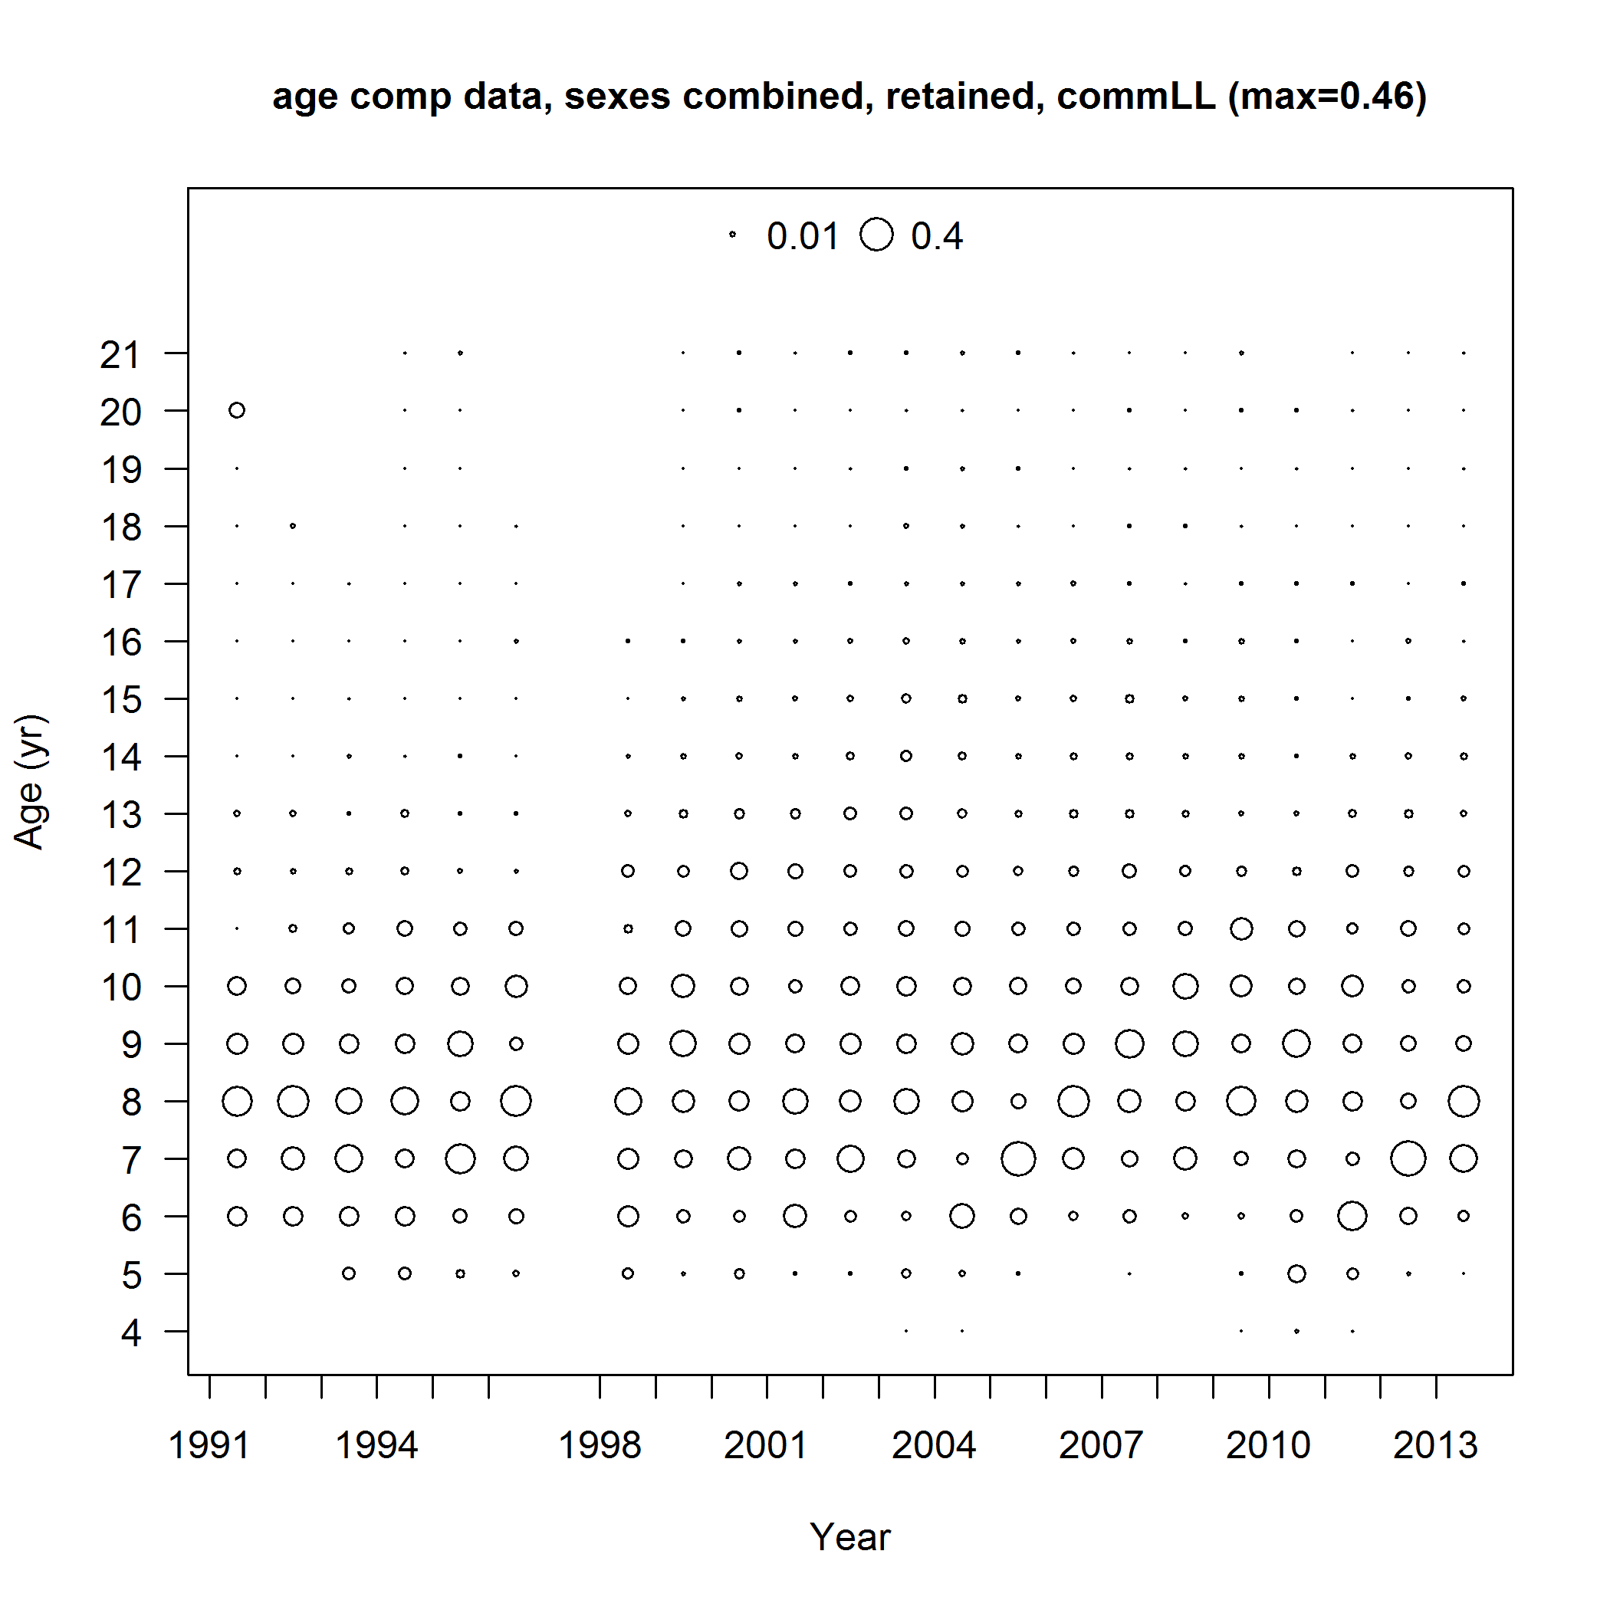
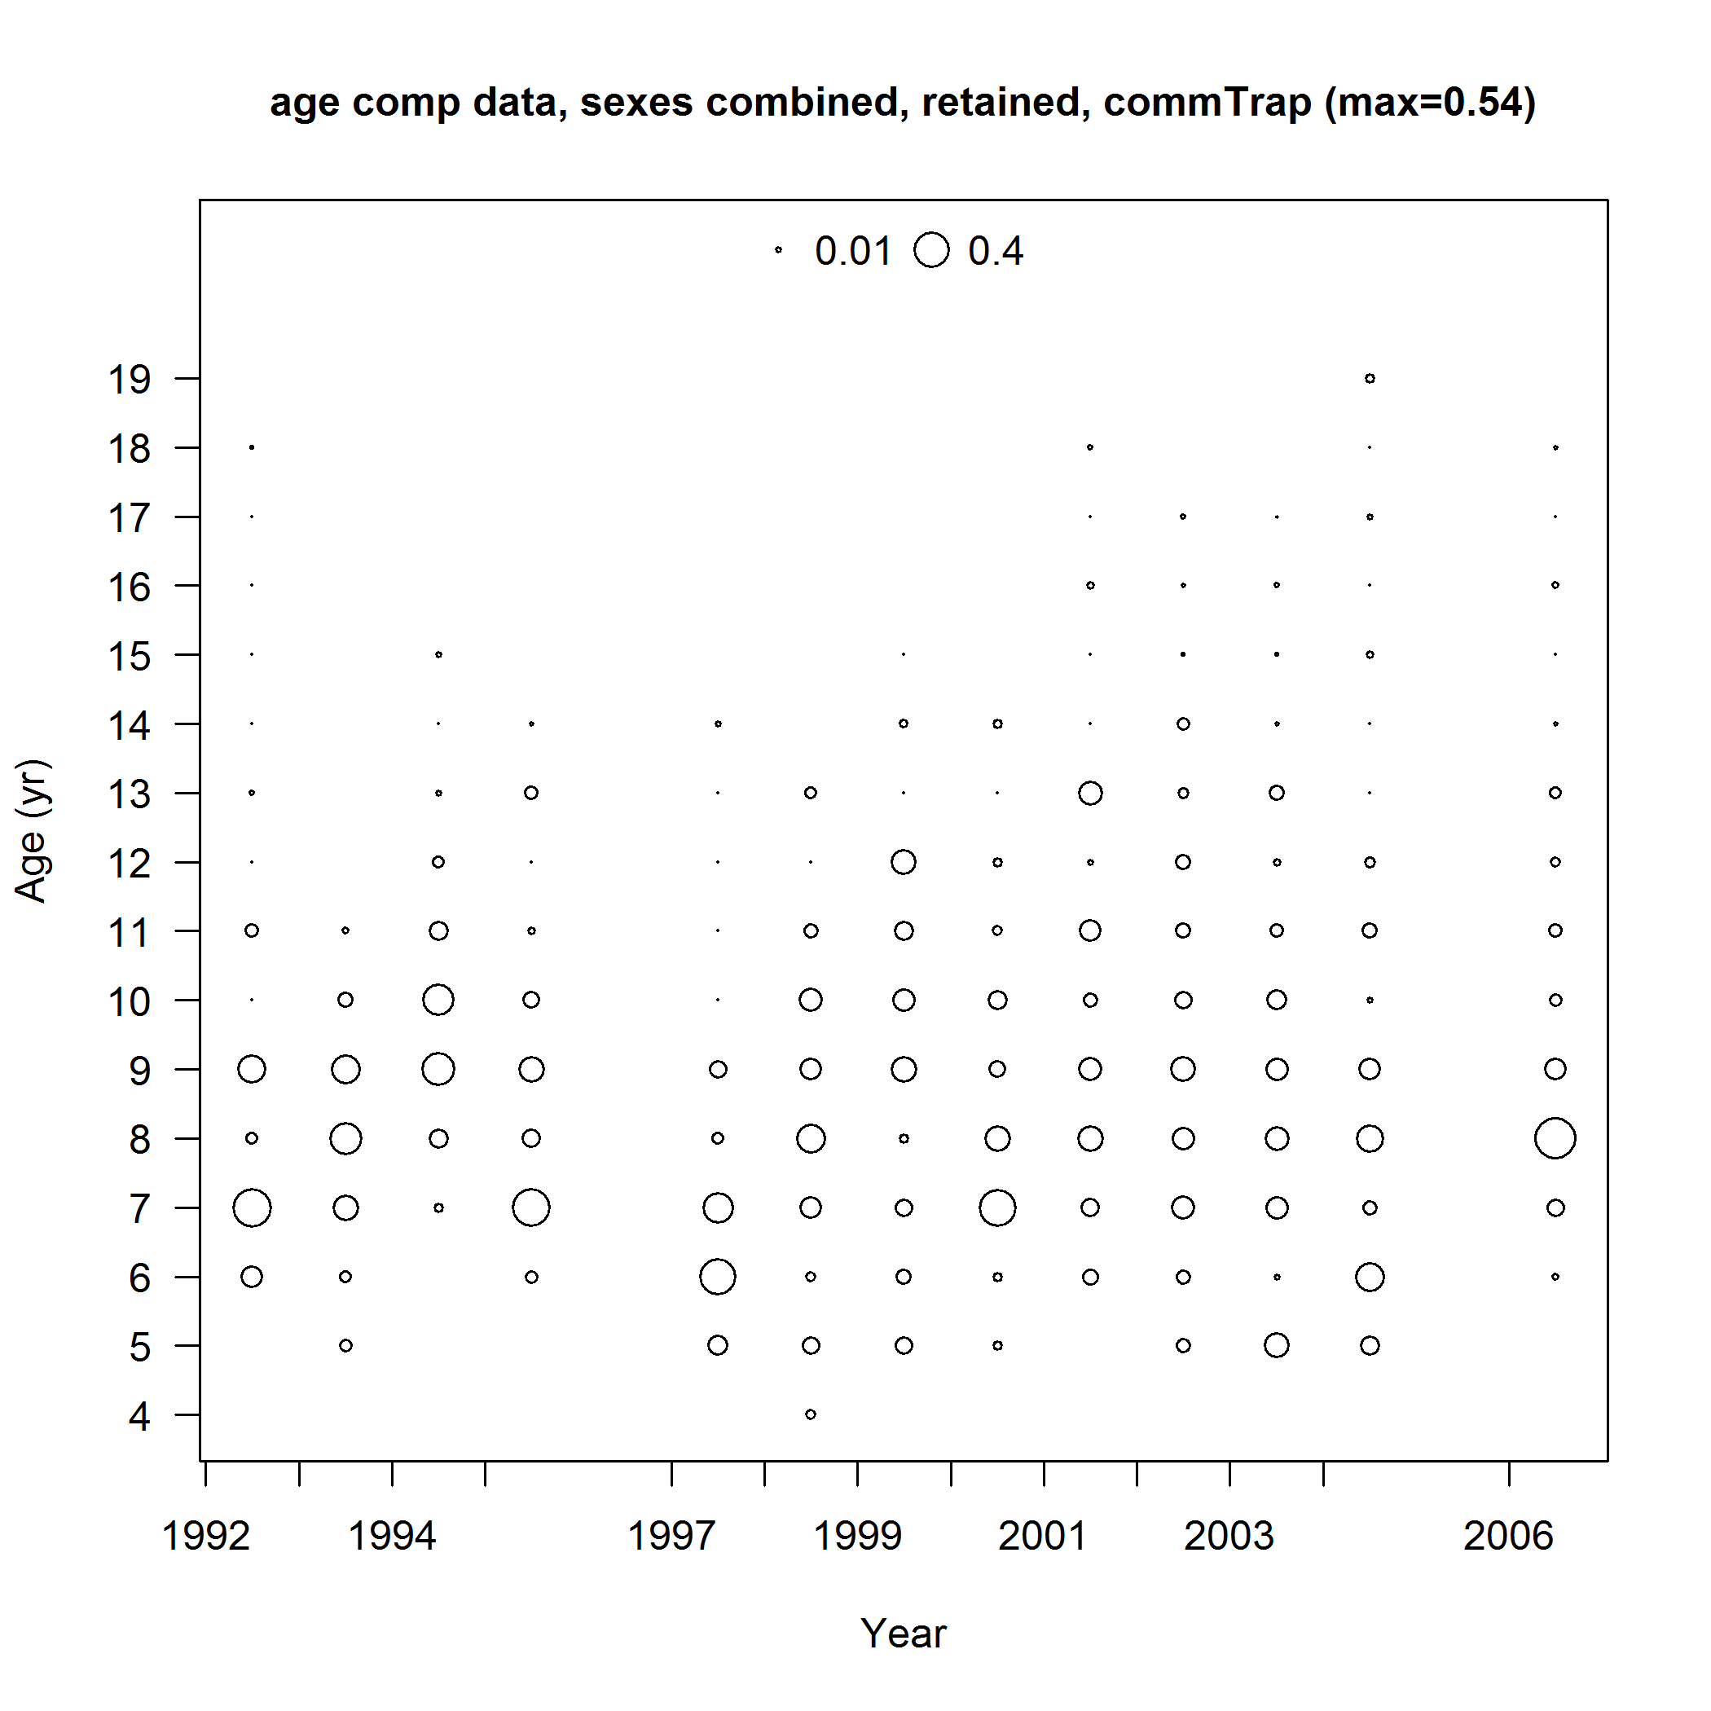
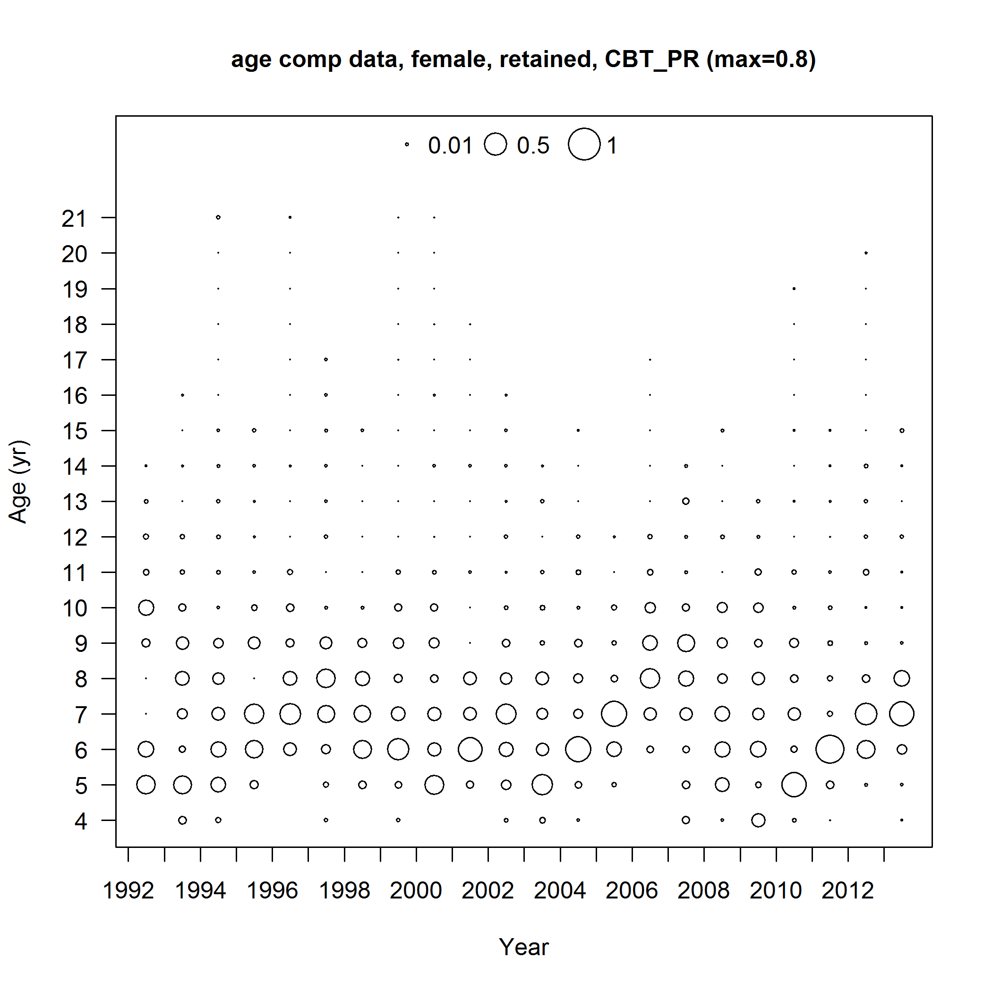
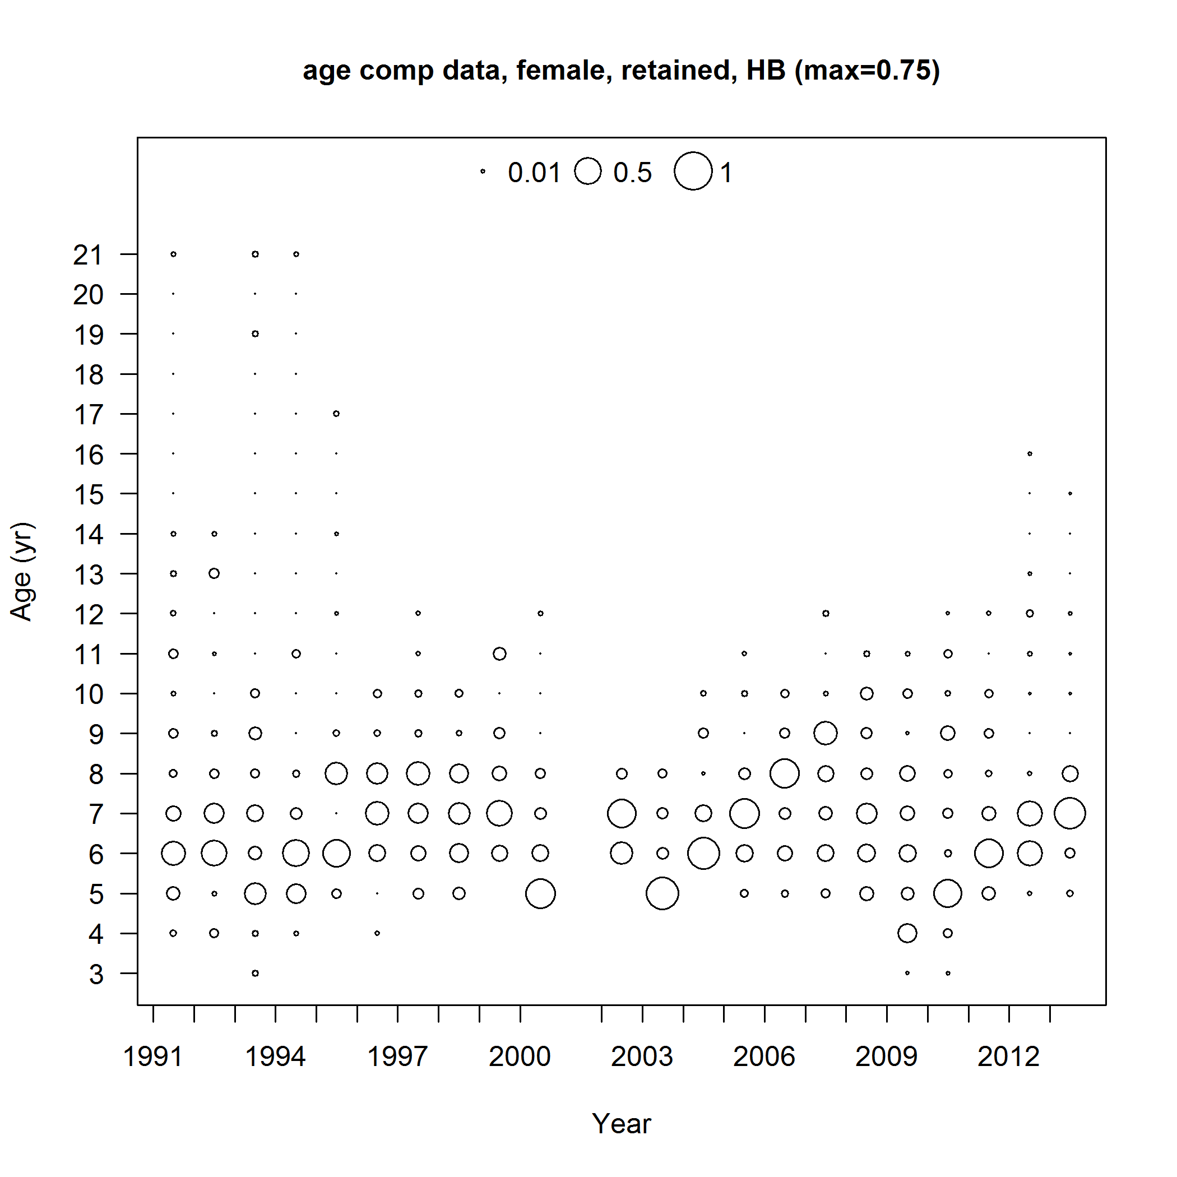
Age composition
Commercial Handline
Commercial Longline
Commercial Trap
5 -11
6 -11
6 -10
Charter/Private
Headboat
5 - 9
5 - 9
Notes:
Generally see at the youngest age-3 or age-4 depending on the fleet.
Prominent age classes are highlighted in red
Fish older than 11 are seen more frequently sampled/seen from the commercial handline and longline fleets.

Slide 35
Age composition
Cohort
Commercial Handline
Commercial Longline
Commercial Trap
1988, 1995, 1998, 2001, 2005
1998, 2001, 2005
Charter/Private
Headboat
1989, 1995, 1998, 2005
1989, 1998, 2005
Notes:
The age composition data also provides information about cohorts over time.
Apparent cohorts:
Comm HL cohorts – 1988, 1995,1998, 2001, and 2005
commLL cohorts – 1998, 2001, 2005
Charterboat cohorts-1989, 1995, 1998, 2005
Headboat cohorts - 1989, 1998, 2005

Slide 36
Length composition
Data Sources
  Discards
    NMFS Observer Program
      Commercial handline (2006 - 2013)
      Commercial longline (2006 - 2013)
    FWRI At-Sea Observer Survey
      Charter (2010 - 2013)
      Headboat (2005 - 2007, 2009 - 2013)
  Fishery-independent surveys
    Video surveys (2008 – 2013)
    SEAMAP summer groundifsh survey (2008 - 2013)
    NMFS bottom longline survey (2001 - 2013)

Slide 37
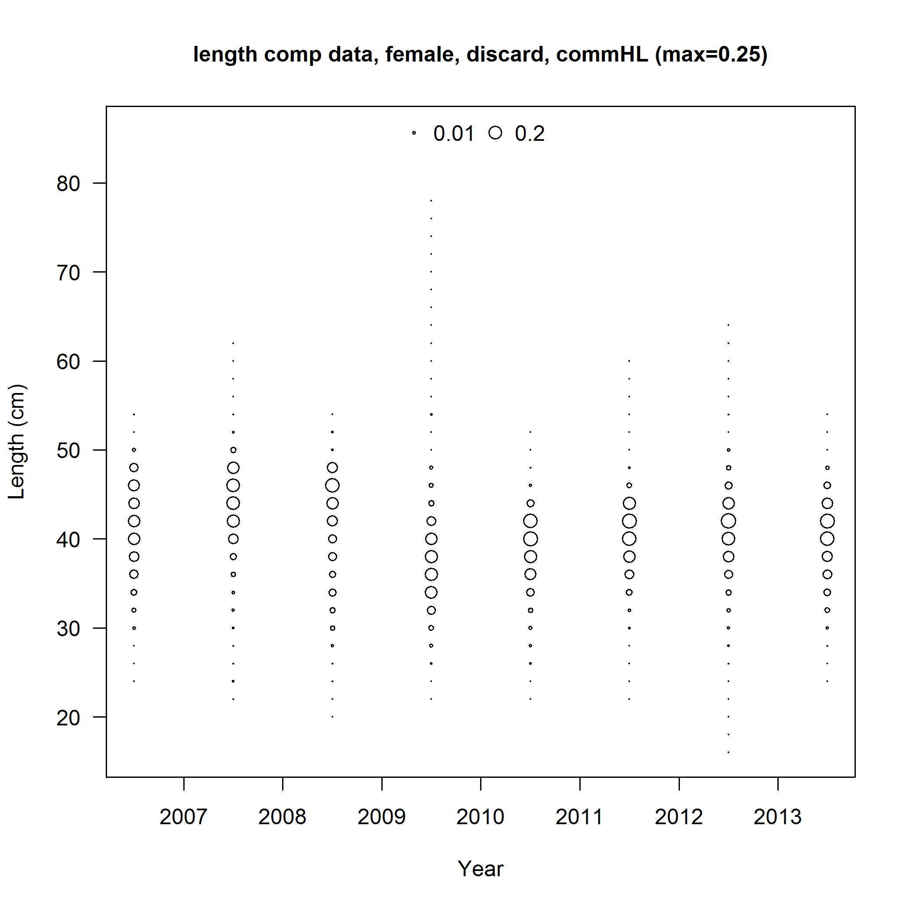
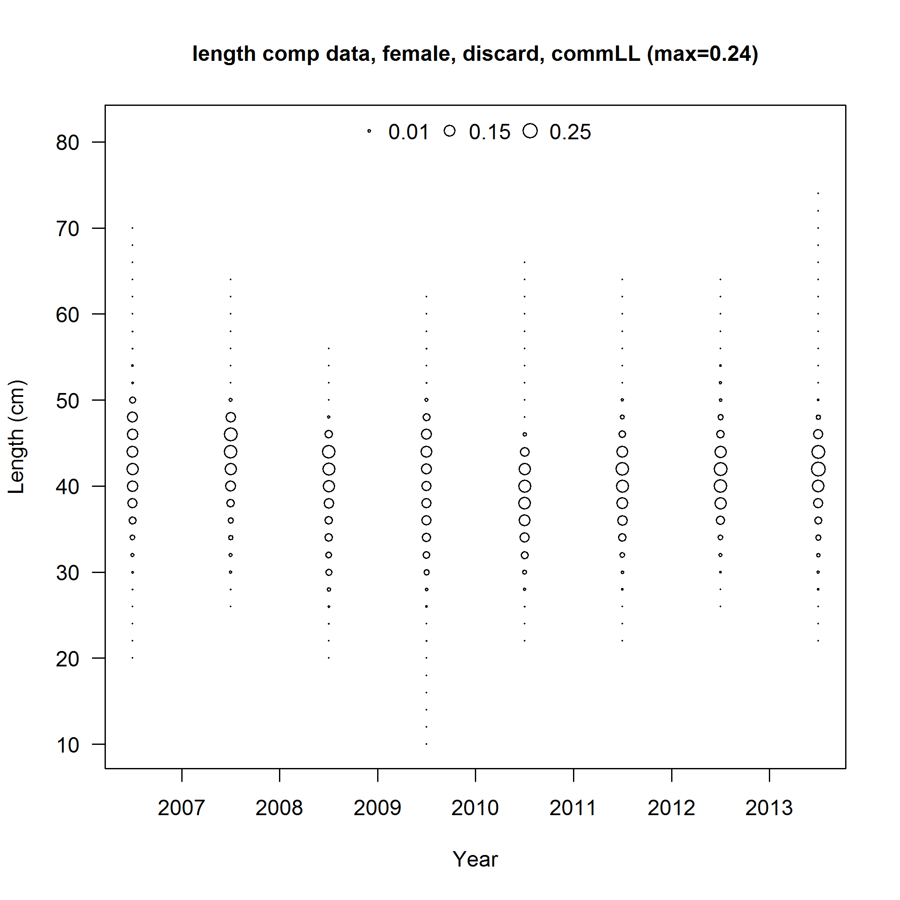
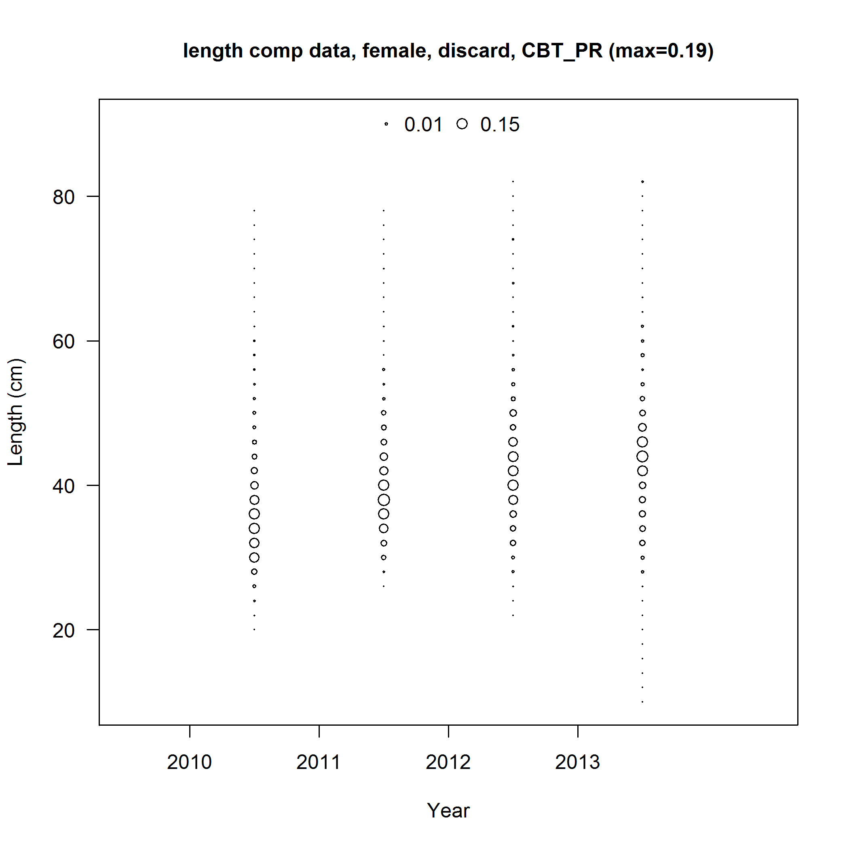
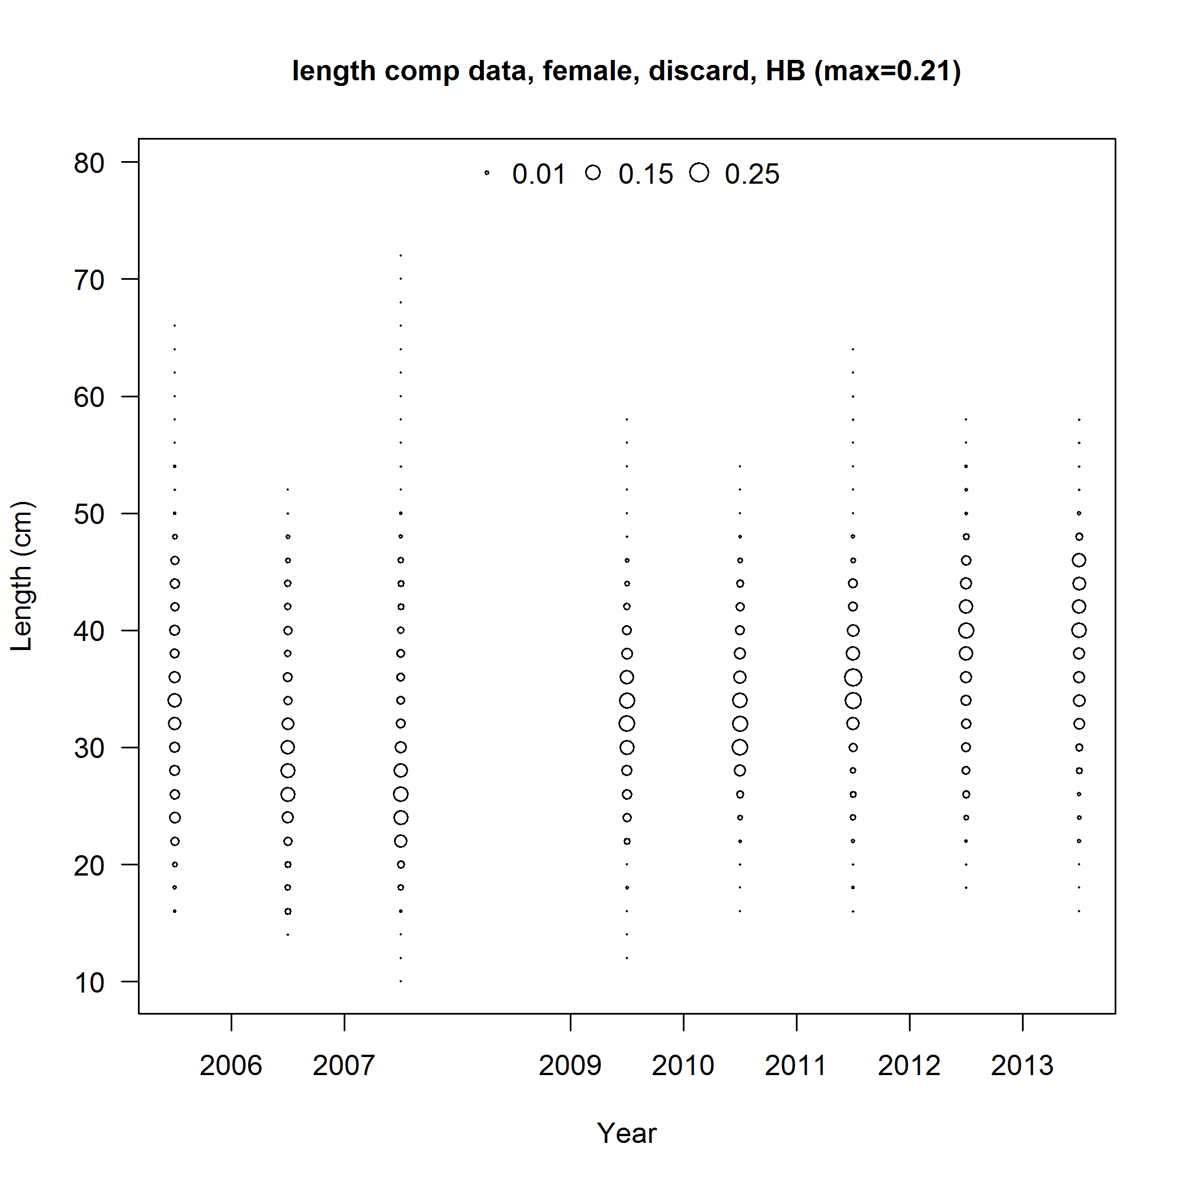
Length composition - discards
20 inch TL size limit
18 inch TL size limit
IFQ program
Commercial Handline
Commercial Longline
Charter
Headboat
Notes:
Generally discarding fish at or smaller than the size limit, except in recent years fish above size limit are seen in the discards

Slide 38
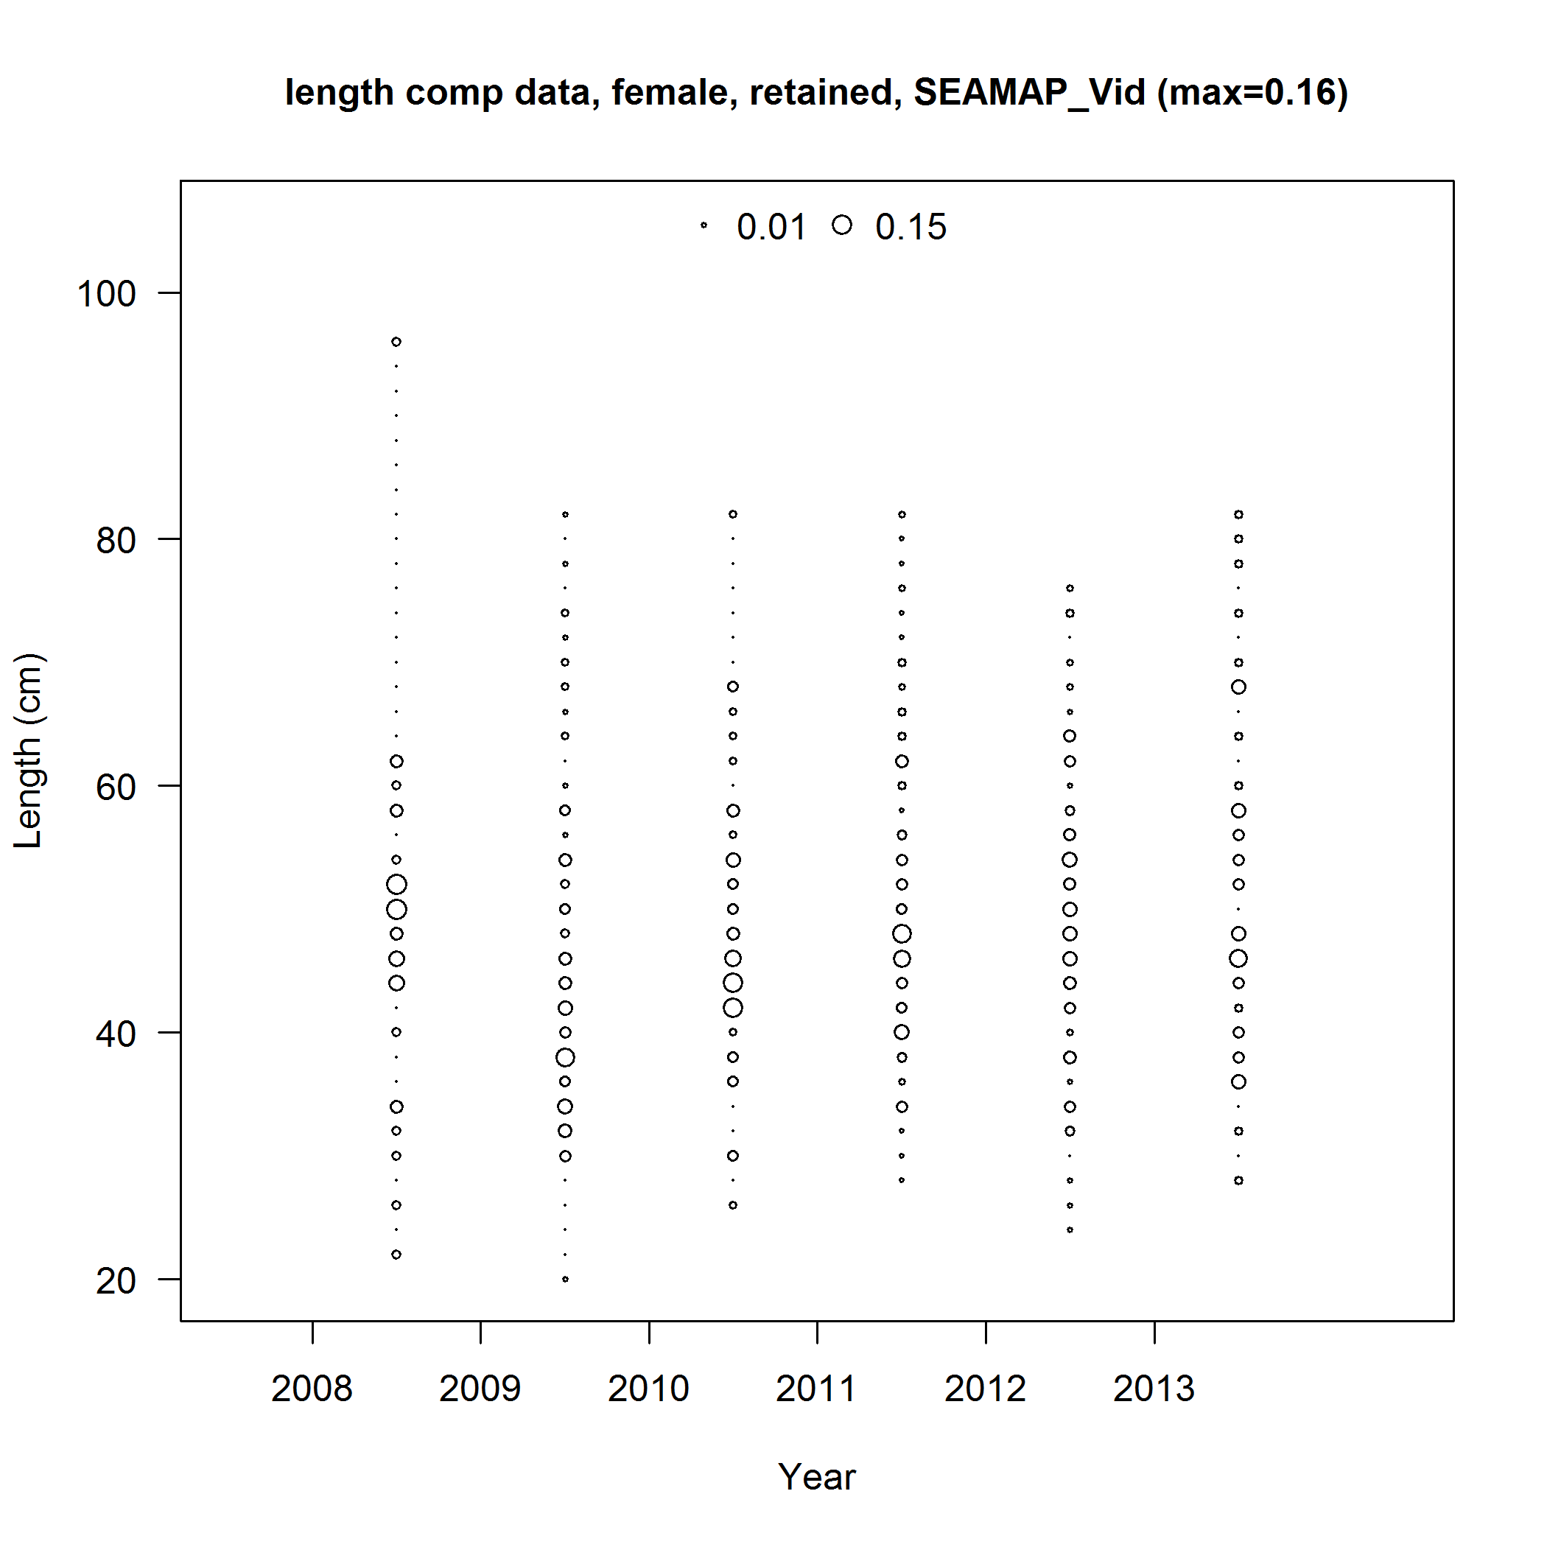
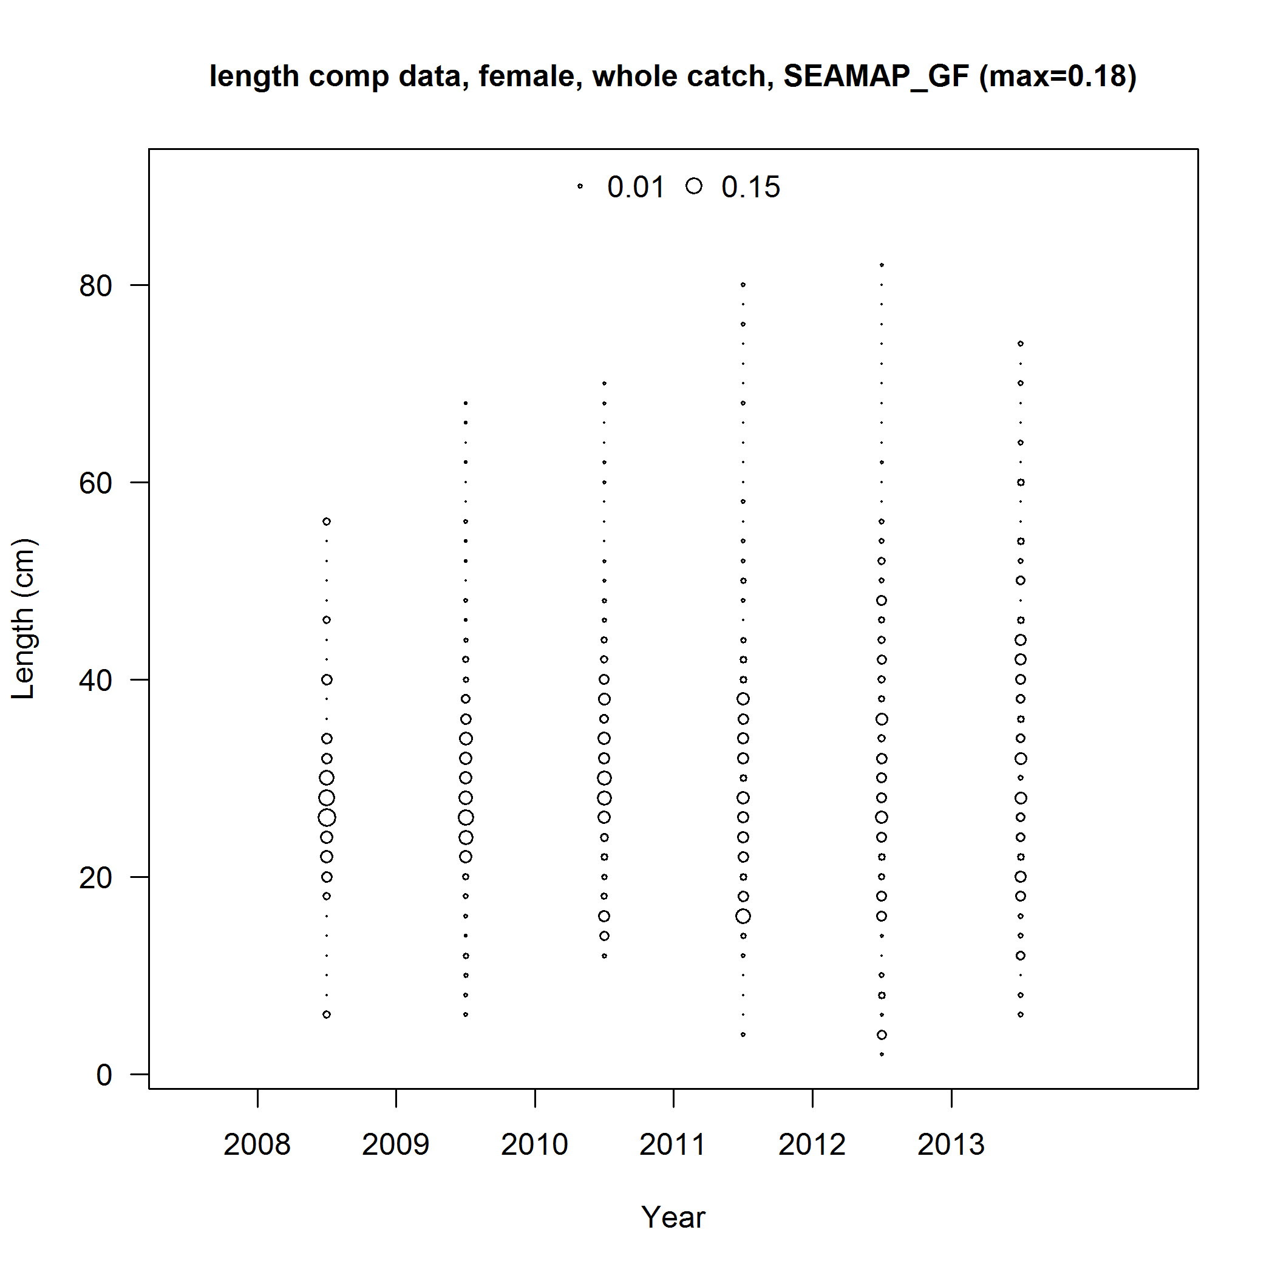
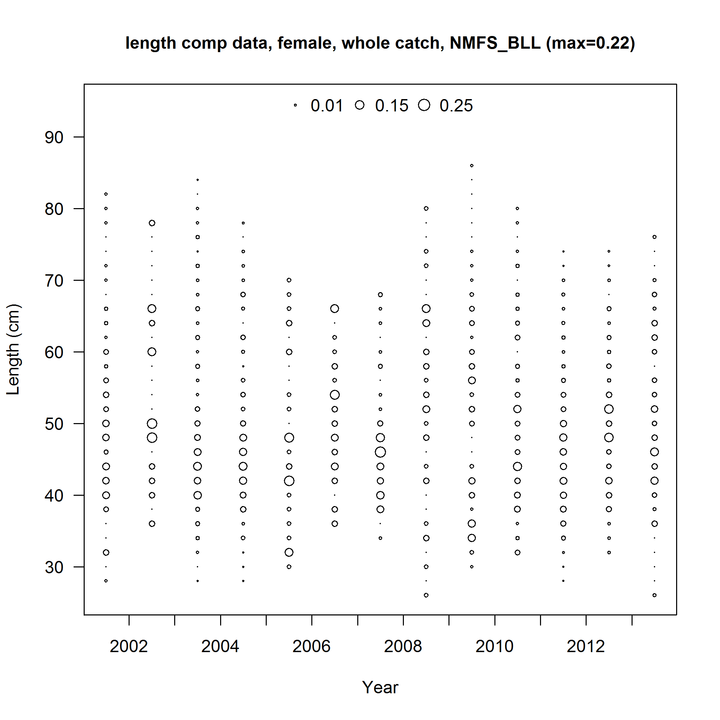
Length composition – Fishery independent surveys
Combined video
20 – 100 cm FL
SEAMAP summer groundfish
0 – 80 cm FL
NMFS bottom longline
30 – 90 cm FL
Notes:
Point out that the y-axes are different.
SEAMAP-GF is capturing smaller red grouper than the other two surveys.
No obvious recruitment pulses.

Slide 39
EXTRA SLIDES

Slide 40
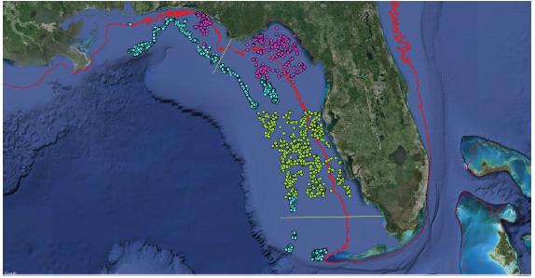
Combined video index
Standardization method
  Poisson sub-model for nonzero data
  Binomial sub-model for presence-absence data
PC Lab
FWRI
SEAMAP

Slide 41
Standardization methods
Delta-lognormal model (Lo et al., 1992 )
  Commercial handline
  Charter/Private
  Headboat
  SEAMAP summer groundfish survey
  NMFS bottom longline survey
Lognormal model
  Commercial longline (high proportion of positive trips)
Delta-Poisson model
  Combined video survey
Notes:
All delta-log normal method except longline and video
Delta lognormal – lognormal submodel for nonzero data, binomial submodel fit to the presence-absence data
Delta-Poisson - lognormal submodel for nonzero data, Poisson submodel fit to the presence-absence data

Slide 42
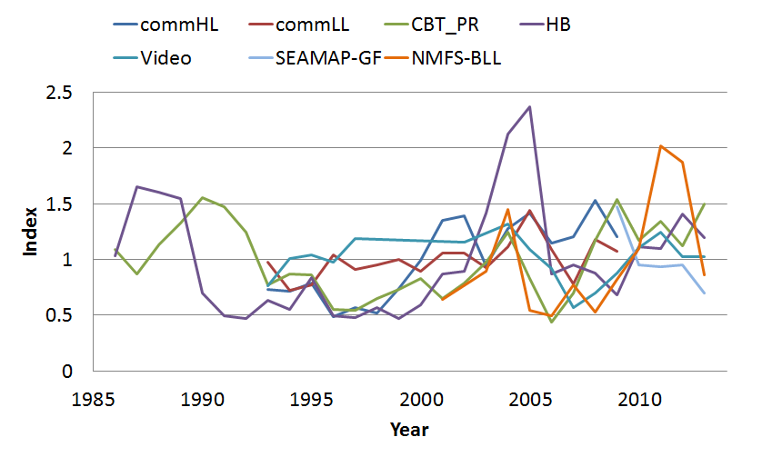
Indices
 | commHL | commLL | MRFSS | HB | Video | NMFS_BLL | SEAMAP_GF
commHL | 1
commLL | 0.56 | 1
CBT_PR | 0.43 | 0.18 | 1
HB | 0.57 | 0.60 | 0.18 | 1
Video | -0.13 | 0.18 | 0.17 | 0.37 | 1
NMFS-BLL | -0.28 | -0.25 | 0.45 | 0.17 | 0.60 | 1
SEAMAP-GF | - | - | 0.31 | -0.80 | -0.57 | -0.24 | 1

Slide 43
Discard Fractions
Discard fractions from commercial observer data:
LL: 0.3-0.74 depending on strata
HL: 0.00-1.00 depending on strata
Discard fractions calculated from annual recreational landings and discards estimates
HB: 0.88 mean annual fraction discarded
CBT/PRI: 0.31 mean annual fraction discarded
Notes:
Commercial HL and LL: discards correlated with landings (.72 and .78)
No info on trap

