Slide 1
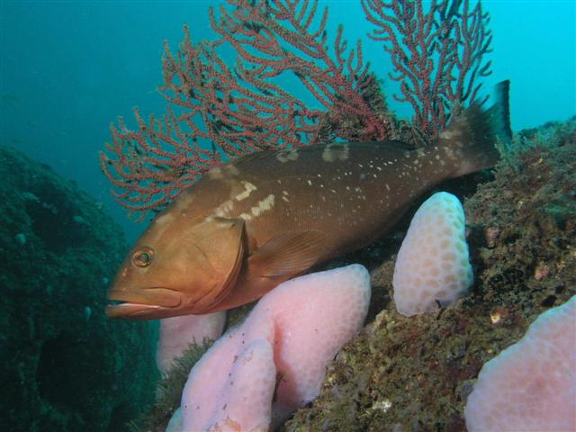
SEDAR 42: US Gulf of Mexico Red grouper assessment
Review Workshop
Introduction
SEFSC
July 14 - 16, 2015

Slide 2
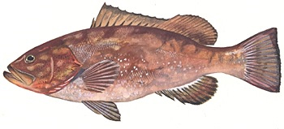
Red Grouper: Epinephelus morio
Physical Description:
Color brownish red
Blotches on sides in unorganized pattern
Pectoral fins longer than pelvic fins; squared off tail
Black dots around the eyes
Sloped, straight line of their spiny dorsal fin

Slide 3
Red Grouper: Epinephelus morio
Distribution:
Found North Carolina to Brazil, including Gulf of Mexico (GOM) and the Caribbean
Most abundant along FL east and west coasts, and throughout GOM
Bottom dwelling fish associated with hard bottoms
Juveniles are found offshore along with adults greater than 6 years old
  Fish from 1 to 6 years occupy nearshore reefs

Slide 4
Red Grouper: Epinephelus morio
Biology:
Protogynous hermaphrodite (females becoming males as they age)
Spawns in April and May
  Peak mid-May
  Harems
Lifespan at least 25 years

Slide 5
important species in the Gulf of Mexico, particularly in West Florida
In West FL, 2003-2012: Red Grouper made up 25% of total revenue without shellfish (9% of total revenue).

Slide 6
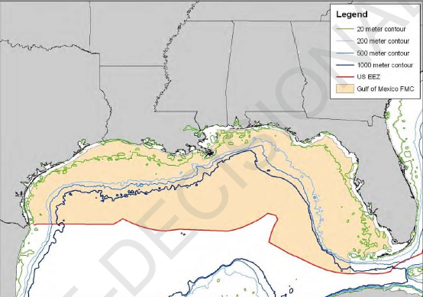
Stock/Management boundary
Gulf of Mexico stock is separated from the South Atlantic at council boundary line
  Boundary – U.S. Highway 1 in the Florida Keys
  Following same recommendation as SEDAR 12
Notes:
Recommend by the life history work group given that there has been a lack of data indicating that there is mixing between red grouper in the GOM and Atlantic.

Slide 7
Assessment history
1991 – Catch curve analysis and per recruit analyses
  Stock not overfished in 1990
1993 – Virtual Population Analysis
  Assessment results were deemed invalid
1999 – Age Structured Assessment Program (ASAP)
  Stock was overfished and experiencing overfishing in 1997
2006 – ASAP
  Stock not overfished nor experiencing overfishing
2009 – Update assessment using ASAP
  Accounted for red tide event in 2005
  Stock not overfished nor experiencing overfishing in 2008
Notes:
There have been a series of assessments since 1991 using various assessment methods and model improvements to the assessment process over time.
Assessments between 1999 and 2009 used a forward projecting catch-at-age model called the Age Structured Assessment Program or ASAP for short.
In 1999, the red grouper stock was considered to be overfished and experiencing overfishing.
In 2006, the stock status improved and in 2009, the stock status was similar to 2006.

Slide 8
GOM Red Grouper Regulations
Commercial | Recreational
Seasonal Spawning Closures | Seasonal Spawning Closures
Quotas/ACL | Quotas/ACL
Commercial IFQ program
Size limits | Size limits
 | Trip limits

Slide 9
GOM Red Grouper Regulations
Seasonal Closures
Quotas
Comm. IFQs
Size Limits
Bag Limits
Notes:
Black squares are years with end of year closures:
Comm: 8Nov1990, 15Nov2004, 10Oct2005
Rec: 1Nov2005
Seasonal Closures for reproduction: 2/15 – 3/14, then 2/1 – 3/31
Quotas have been stable since their implementation

Slide 10
GOM Red Grouper Regulations
Seasonal Closures
Quotas
Comm. IFQs
Size Limits
Bag Limits

Slide 11
SEDAR 42 Red Grouper Assessment
Continuity model (psuedo-continuity)
Data inputs
Assessment model configuration
Model fit to data
Model diagnostics
Stock status determination
Projections
Notes:
Order of presentation

Slide 12
Continuity model

Slide 13
Red grouper benchmark assessment
2015 benchmark will use Stock Synthesis (Methot and Wetzel 2013) as the assessment modeling platform
  Integrated assessment model
  Statistical catch-at-age model
SEDAR 12 and 2009/2010 update assessment used Age Structured Assessment Program (Legault and Restrepo)
  Forward projecting statistical catch-at-age model

Slide 14
Continuity
Create an SS model that is similar to the ASAP model used previously using the same data as the 2009/2010 update assessment
Goal is to demonstrate that ASAP and SS produce similar results

Slide 15
ASAP configuration
Four fleets with landings and dead discards
  Commercial handline: 1986 - 2008
  Commercial longline: 1986 - 2008
  Commercial trap: 1986 - 2006
  Recreational: 1986 -2008
Six indices of abundance
  Fishery dependent: commercial handline, commercial longline, MRFSS, headboat (1986-1990), headboat (1990-2008)
  Fishery independent: SEAMAP video (1993-1997, 2002, 2004-8)
Age composition for all fleets
  Direct age composition data for landings
Ages 1 – 20, age-1 recruits (Beverton-Holt), age-20 = plus group
Episodic natural mortality in 2005

Slide 16
SS continuity model
Same configuration as ASAP
  Continuity
    Natural mortality, growth, fecundity, selectivity, retention and stock-recruitment parameters fixed
  Cont_SelEst
    Natural mortality, growth, fecundity, and retention parameters fixed
    Ro and selectivity parameters estimated

Slide 17
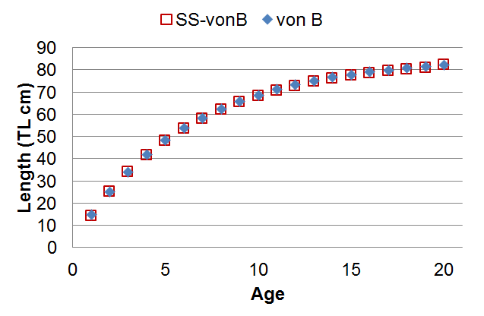
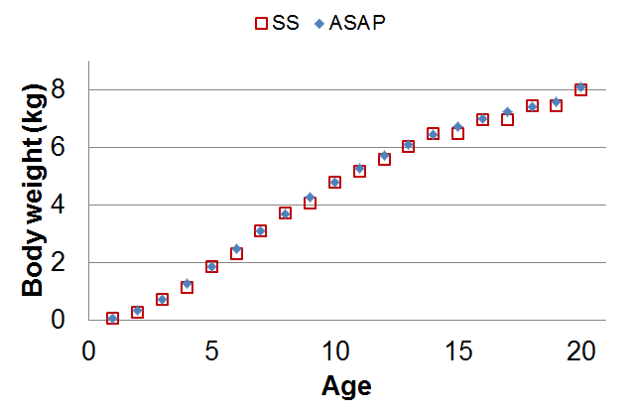
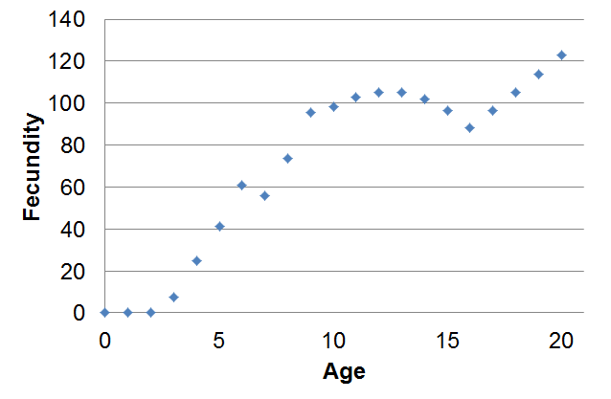
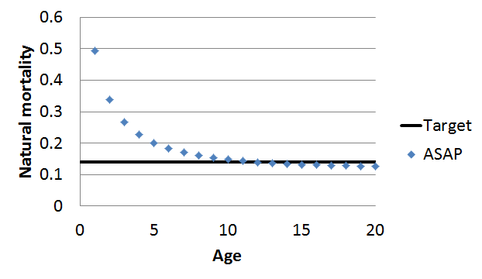
Biology

Slide 18
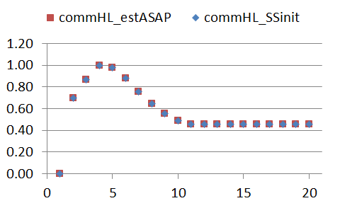
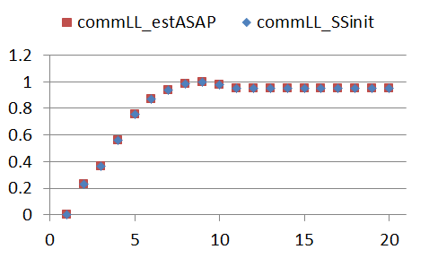
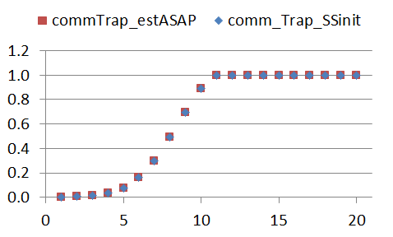
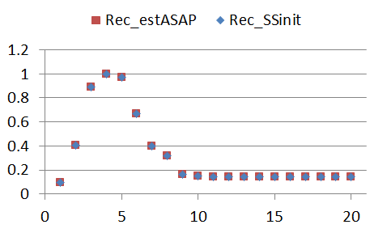
Selectivity
SS input based on ASAP estimated curves
  Random walk

Slide 19
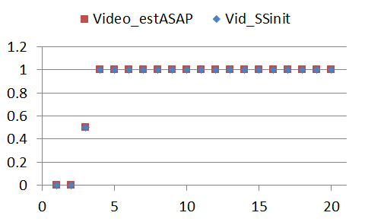
Selectivity
SS input based on ASAP estimated curves
  Logistic

Slide 20
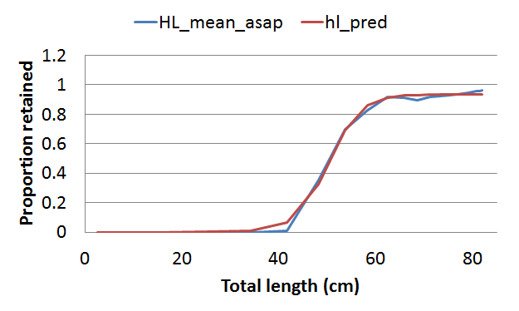
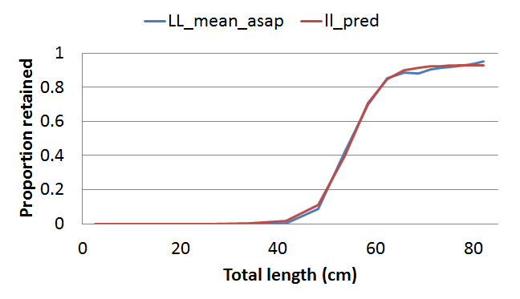
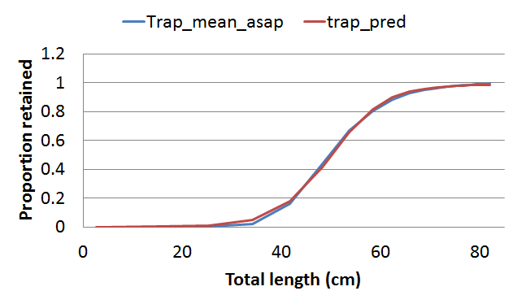
Retention – commercial fleets
1986 – 1989 : Assumed 100% retention (i.e., no discards)
ASAP – time varying retention for 1990 - 2008
SS input – Average relationship for 1990 - 2008

Slide 21
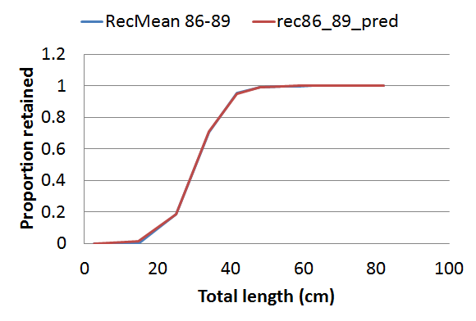
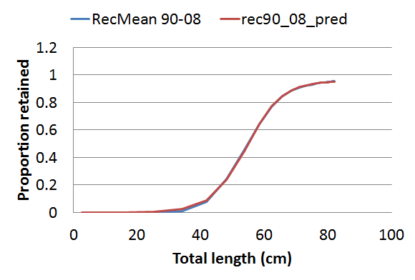
Retention – recreational fleet
Two retention functions
  1986 – 1989: Before 20 inch size limit
  1990 -2008: 20 inch size limit

Slide 22
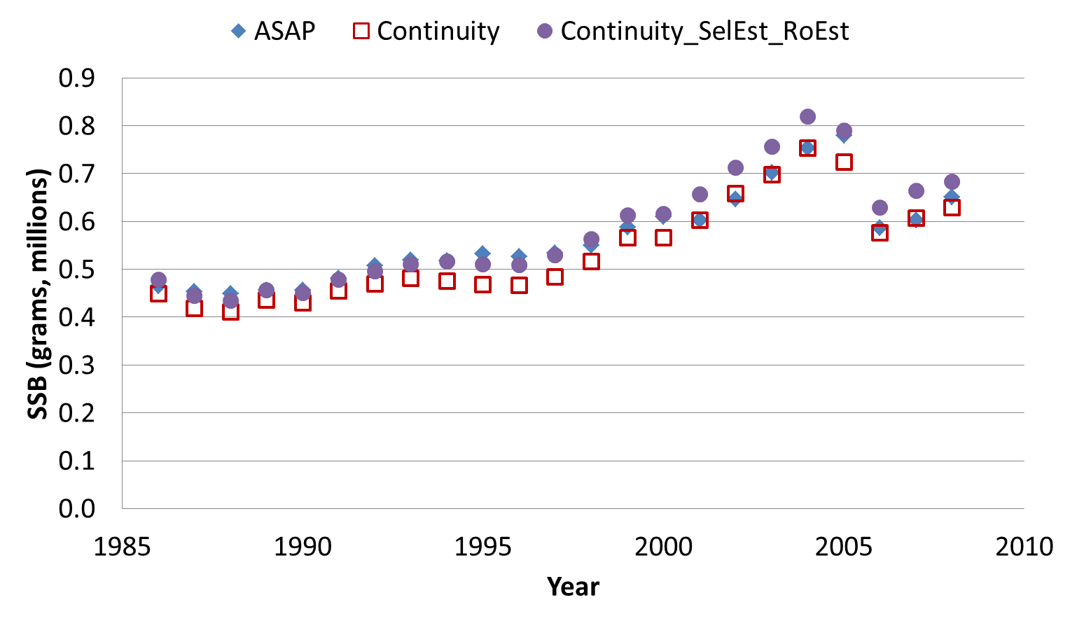
Results – Spawning Stock Biomass

Slide 23
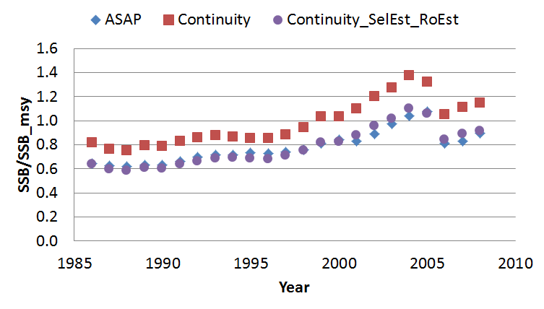
Results – Stock status

Slide 24
Conclusion
SS and ASAP produce similar results
  Provides similar management advice

Slide 25
EXTRA SLIDES

