Slide 1
SEDAR 77: Great hammerhead age and growth
Great hammerhead sample size summary:
 | Atlantic | Gulf | Areas combined
Female | 62 | 106 | 168
Male | 53 | 59 | 112
Sexes combined | 115 | 168 | 283
Great hammerhead length (cm) summary:
 | Atlantic | Gulf
Female | 41.7-357.0 | 54.0-322.0
Male | 40.4-296.7 | 60.0-274.0
Sexes combined | 40.4-357.0 | 55.0-322.0
Size range: 40-400 cm FL, some unverified reports up to 600 cm TL
Maximum size ~ 400 cm and 300 cm FL for females and males, respectively
Just received vertebrae from 162 more individuals

Slide 4
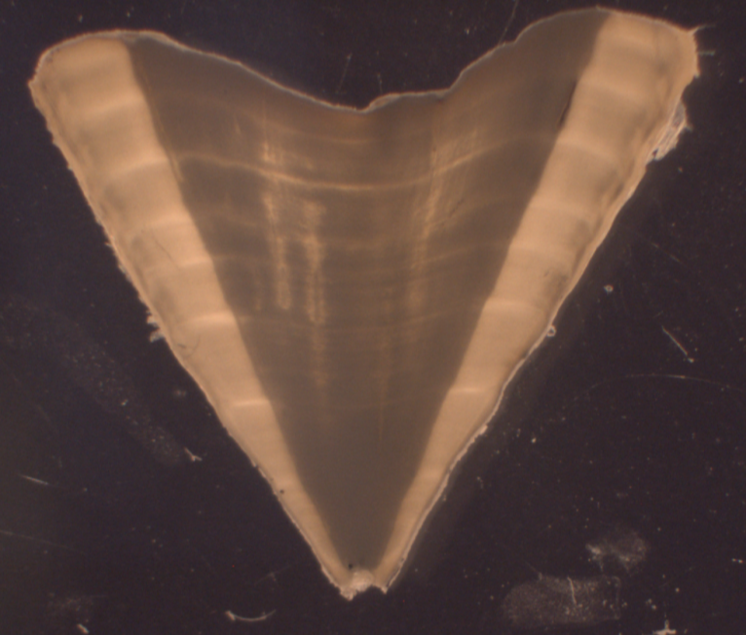
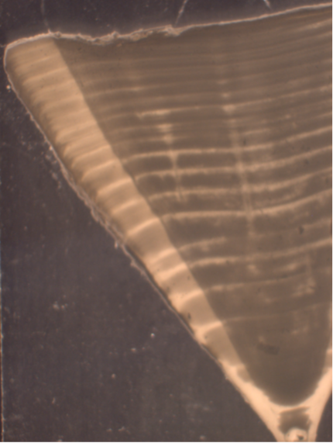
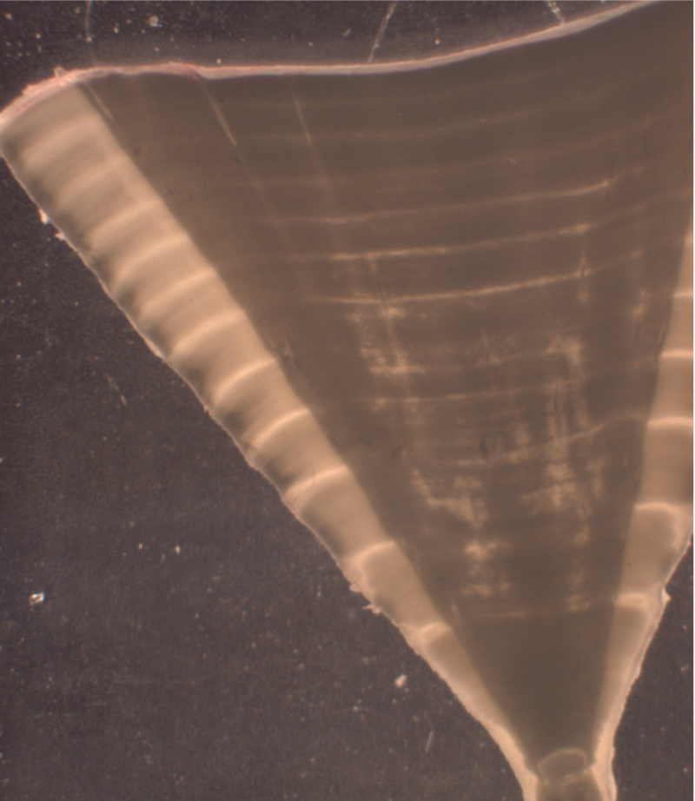

.
.
.
.
.
.
.
.
.
.
.
.
.
.
.
.
.
.
.
.
.
.
.
.
.
.
.
.
.
.
.
.
.
.
.
.
.
8 bands
12 bands
18 bands
Most samples stored in ethanol
0.6 mm transverse section from air dried vertebrae with low speed saw
Counts done under dissecting scope at 7.5 – 15 X magnification
Annual growth band formation was validated using MIA (Piercy et al. 2010) and (Passerotti et al. 2010) using bomb radiocarbon analysis

Slide 5
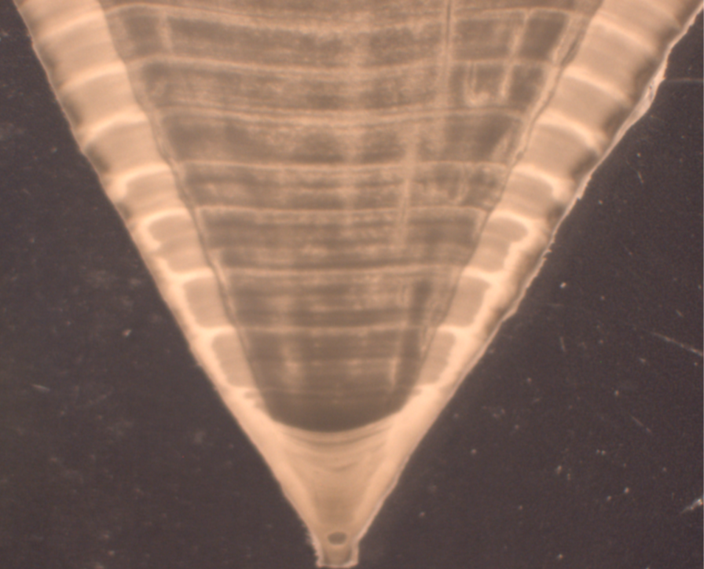
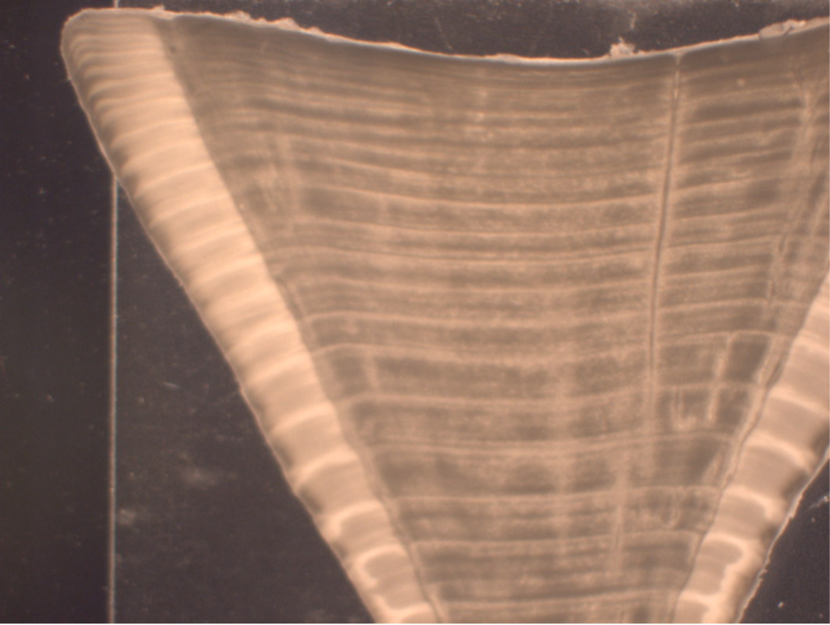

.
.
.
.
.
.
.
.
.
.
.
.
.
.
.
.
.
.
.
.
.
.
.
.
.
.
26 bands

Slide 6
84% were in agreement
96% were within 1 year
100% were within 2 years
Consensus was reached on all vertebrae read
To be consistent with Piercy et al, subtracted 1 from total band count.
If subtract 1.5 k slightly increases (e.g. 0.22 to 0.25)

Slide 8
Area | Sex | L∞ (cm) | k | t_{o} (years) | n | r² | MOA (years)
Atlantic | Female | 316.78 | 0.13 | -1.37 | 62 | 0.95 | 35
 | Male | 250.84 | 0.22 | -0.86 | 53 | 0.96 | 38
 | Combined | 281.76 | 0.17 | -1.10 | 115 | 0.93
Gulf | Female | 357.37 | 0.07 | -3.50 | 106 | 0.92 | 30
 | Male | 251.56 | 0.16 | -2.11 | 59 | 0.92 | 34
 | Combined | 298.00 | 0.11 | -2.80 | 168 | 0.90
Combined | Female | 327.42 | 0.10 | -2.12 | 168 | 0.93
 | Male | 250.29 | 0.19 | -1.34 | 112 | 0.93
 | Combined | 286.99 | 0.14 | -1.74 | 283 | 0.91
Piercy et al. (2010) | Female | 307.8 | 0.11 | -2.86 | 105 | 0.85 | 44
 | Male | 264.2 | 0.16 | -1.99 | 111 | 0.92 | 42
 | Combined | 286.9 | 0.13 | -2.51 | 216 | 0.89
Atlantic v Gulf:
Female: LRT = 18.79, p < 0.01
Male: LRT = 22.18, p < 0.01
Combined: LRT = 28.30, p < 0.01
VBGF trends opposite of what is observed in other species
Increased sample size (n = 162) with addition of UF samples will be helpful

Slide 9
Life History Group conclusions:
Significant differences in VBGF parameter estimates for great hammerheads
Appears to also be the case for scalloped hammerheads
Limited confidence that differences are real
Low sample sizes in specific cases / counter to life history patterns in similar species
In the case of scalloped hammerheads, no confidence that S. gilberti samples weren’t included
Problematic due to potential and likely life history differences between S. gilberti/lewini
Opinion of group participants that decision on stock ID should not be based on life history

